Slide 1
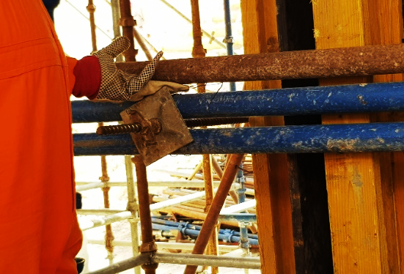
PDO Incident First Alert
Incident type | LTI (08)
Date/ time | 24.03.18 @11:30hrs | Directorate
Location | Yibal | Dept
What happened
While a Carpenter was dismantling a scaffolding pipe, the pipe slipped crushing his left hand against the edge of the tie-rod resulting in a fracture to his left hand ring finger.
Mr. Musleh asks the questions of can it happen to you?
Do you ensure you keep your hands away of crush points?
Do you stop and ask for help when needed?
Do you ensure you are handling the scaffold correctly ?
Pipe dropped onto hand
Please disseminate this LTI notification to your teams and use it in your tool box talks and HSE meetings and notice boards.

