Slide 1
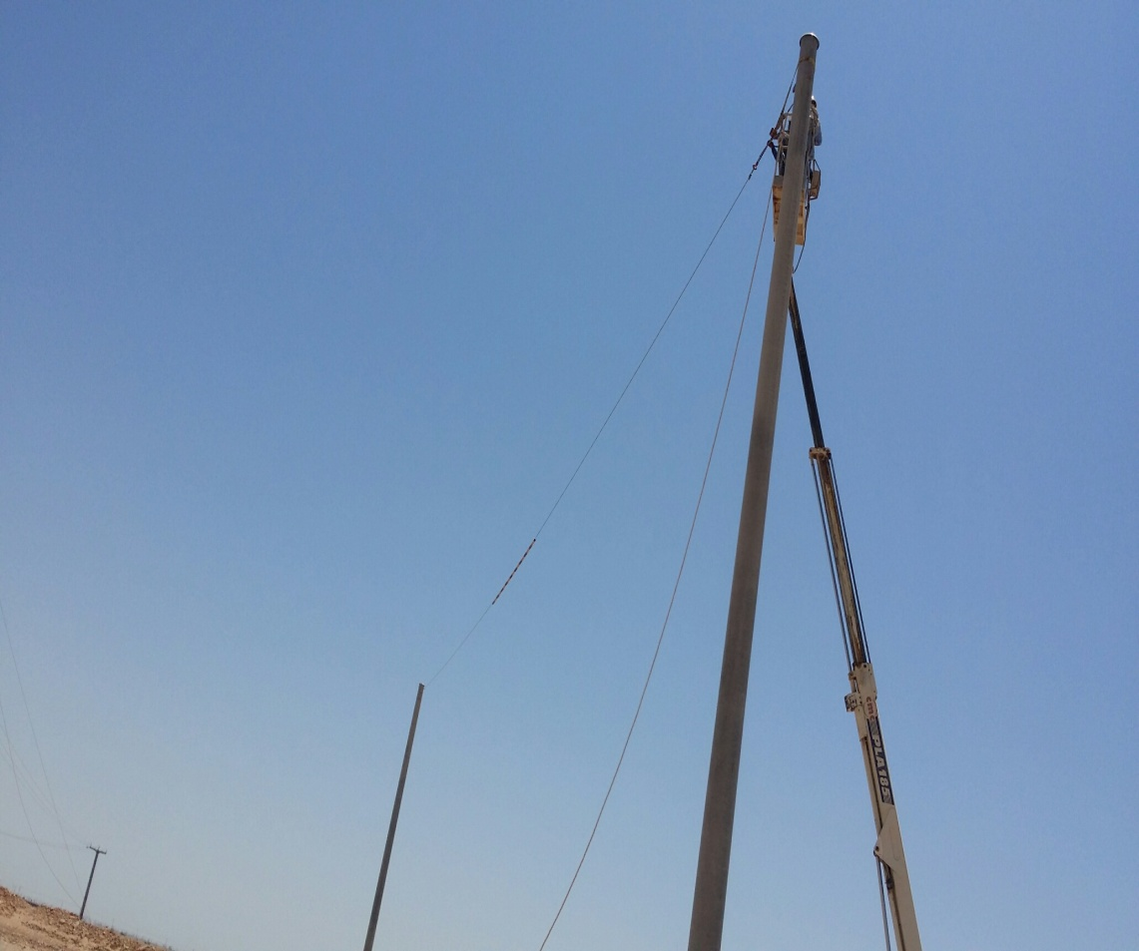
Safety Alert
Use this Alert: Discuss in Tool Box Talks and HSE Meetings ➔ Distribute to contractors ➔ Post on HSE Notice Boards ➔ Include in site HSE Induction
Over Head Lines (OHL) and kicker boards #02
During a recent Rig Move, several kicker board (KB) lines were removed to allow a clear path for the rig mast without shutting off the power to the lines.
Do not remove KB lines
Do not travel under live OHL’s without KB in place
Notify Electrical department when lines are too low
Ensure you have written permission for any changes agreed

Slide 2
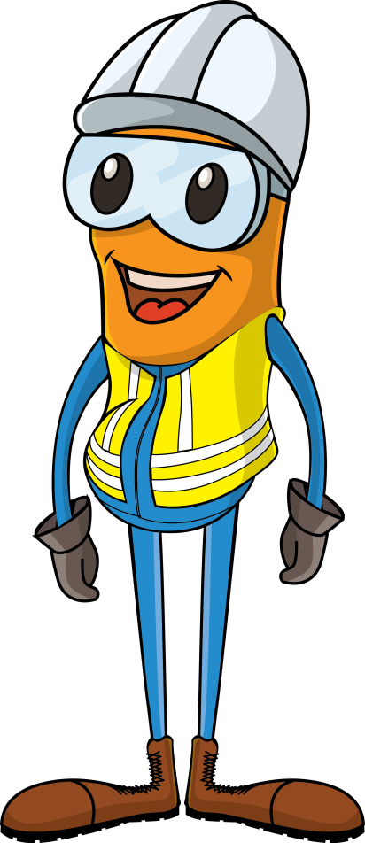
Safety Alert
Mr. Musleh asks the questions of can it happen to you?
Do you ensure the kicker boards (KB) are in place?
Are all kicker boards and OHL measured and recorded during the Route Survey?
Do you report inaccuracies of kicker board heights?
Are staff reminded of overhead power lines during TBT’s?
Do you ensure you have written permission from the Electrical Department before carrying out any work on KB and OHL’s?
Do you ensure you adhere to the requirements of SP-1242?

