Slide 1
Safe Driving
During
Eid Holidays
Our Smile
Your Responsibility
Don’t Extinguish It!

Slide 2
You deserve Eid enjoyment
Eid celebration is about having great times with Family & friends, which can be achieved by having proper safe planning for the Eid activities and reflecting safe driving behaviours on the roads.
You are responsible for your own Safety!

Slide 3
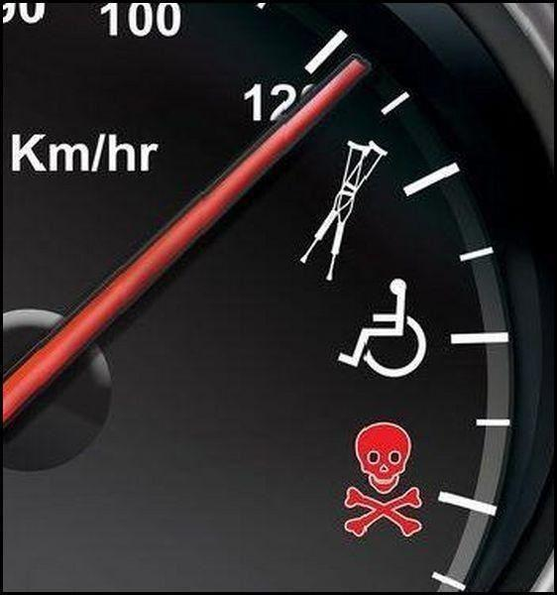
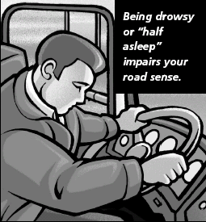
Safety Lessons Learned from Previous Eid Holidays
Over-speeding ..
Maintain speed limits .. Drive safely.
Mobile Phones / Texting
Keep your phone out of reach
Switch off mobile data, check calls/messages when stopped safely
Fatigue ..
Take enough rest before your trip
Plan your trip with frequent rest stops
Remember
To ..
Always check your vehicle before a long trip
Speeding
Always wear seat belt

Slide 4
Safe driving behaviors
Getting adequate rest prior to any trip to avoid fatigue.
Performing vehicle pre trip inspection (Tyre, lubricants, coolant, belts, battery, lightning…etc).
Check around the vehicle before moving,
make sure it’s free from children or other obstacles.
Wearing safety belt and ensuring passengers do so.
Complying with safe driving speed limits.
Stopping vehicle while using mobile phone.
Keeping safe distance on the road.
Remaining alert and respecting other road users.

Slide 5
Remember that..
Safe driving behaviors
Your behavior
influences your risk management on the road – You are in control.

Slide 6
Have an enjoyable and safe Eid!

