Slide 1
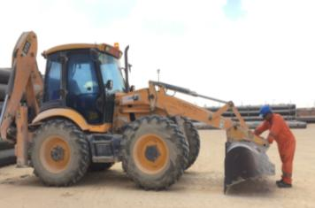
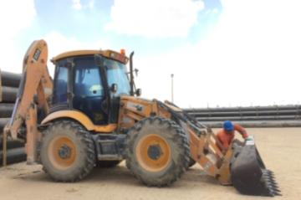
PDO Second Alert
Date: 21.02.2018 Incident LTI – Foot Fracture
What happened?
An Operator of backhoe loader tried to remove a stuck stone in the bucket release assembly by pulling the lever while the bucket was not rested properly on ground. As soon as he pulled the lever the bucket dropped resulting in a crush injury to foot.
Your learning from this incident..
Always stay away from line of fire
Only operate equipment you are competent to operate
Follow manufacturers instructions
Ensure bucket is in safe position while using the detaching lever
Never place yourself in “line of fire”

Slide 2
Management self audit
Date: 21.02.2018 Incident: LTI – Foot Fracture
As a learning from this incident and to ensure continual improvement all contract
managers must review their HSE HEMP against the questions asked below
Confirm the following:
Do you ensure that all risks are well managed and adequate controls are implemented (e.g. during routine maintenance activities)?
Do you ensure that the operators deployed are competent enough to carryout plant operations safely?
Do you have robust competence assessment system for all operators?
Notes:
Make a list of closed questions (only ‘yes’ or ‘no’ as an answer) to ask other contractors if they have the same issues based on the management or HSE-MS failings or shortfalls identified in the investigation. Pretend you have to audit other companies to see if they could have the same issues.

