Slide 1
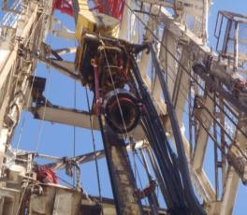
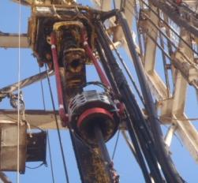
PDO Second Alert
Date: 16.01.2018 Incident title: HiPo Dropped object (EQD)
What happened?
During running in 4 1/2" completion tubing joint # 44, the Driller side air winch line caught in the extended TDS link tilt bracket causing parting of the winch line. The tail chain of winch line dropped 9 meters to the rig floor, and a 1.2 Ton power tong dropped from a height of 80 cm to rig floor. The dropped tail chain hit the TDS link tilt hydraulic hose which got punctured.
Your learning from this incident..
Ensure winch line is free from obstacles.
Report all Near miss no matter how small, in timely manner so that it is investigated and lesson learnt
Stop the operation if you see anything unsafe.
Ensure to discuss potential dynamics drops in pre job meeting (JSA / TRIC)
Always adhere to red zone management
Incorrect Tie Back
Ensure equipment is tied back correctly and all lines are free from obstacles
Correct Tie Back

Slide 2
Management self audit
Date: 16.01.2018 Incident title: HiPo Dropped object (EQD)
As a learning from this incident and ensure continual improvement all contract
managers must review their HSE HEMP against the questions asked below
Confirm the following:
Do you ensure dynamic DROPS are captured in your audit?
Do you ensure your team is reporting near misses?
Do you ensure your team understands what a near miss is?
Do you ensure best practice of counter weight for winch lines?
Notes:
Make a list of closed questions (only ‘yes’ or ‘no’ as an answer) to ask other contractors if they have the same issues based on the management or HSE-MS failings or shortfalls identified in the investigation. Pretend you have to audit other companies to see if they could have the same issues.

