Slide 1
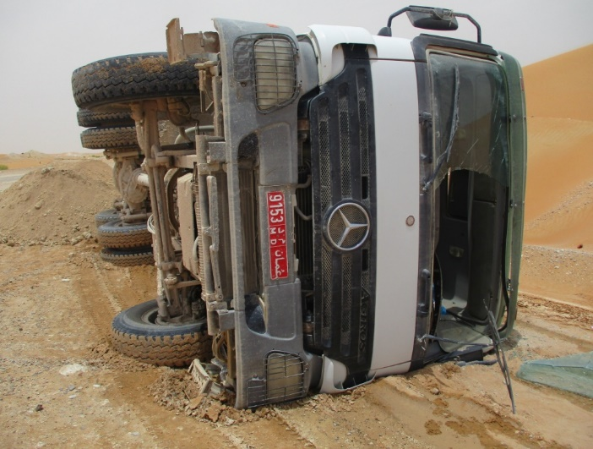
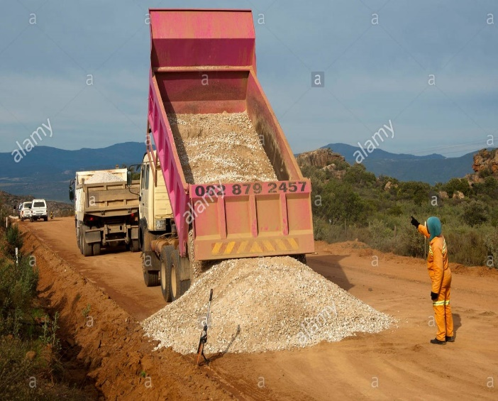
PDO Second Alert
Date: 28.04.2018 Incident title: HiPo
What happened?
While the tipper driver was offloading the soil in the work location for road resetting work, due to the uneven surface the tipper fall to the side.
Your learning from this incident..
Ensure the surface condition before parking
Always ensure banksman is used for vehicle movement, reversing and offloading materials.
Ensure TRIC been used effectively.
Ensure proper planning and adequate resources available for the activity
Adequate supervision
You are Empowered to STOP if not Safe
Seek assistance of Banksman while reversing the vehicle

Slide 2
Management self audit
Date: 28.04.2018 Incident title: HiPo
As a learning from this incident and to ensure continual improvement all contract managers must review their HSE HEMP against the questions asked below
Confirm the following:
Do you ensure adequate manpower resources available to perform the activity?
Do you ensure your HEMP covers all the hazards involved in each task and is communicated to your workforce?
Do you ensure your TBT covers all associated hazards for the activity?
Do you empower your team to stop unsafe act/condition?
Notes:
Make a list of closed questions (only ‘yes’ or ‘no’ as an answer) to ask other contractors if they have the same issues based on the management or HSE-MS failings or shortfalls identified in the investigation. Pretend you have to audit other companies to see if they could have the same issues.

