Slide 1
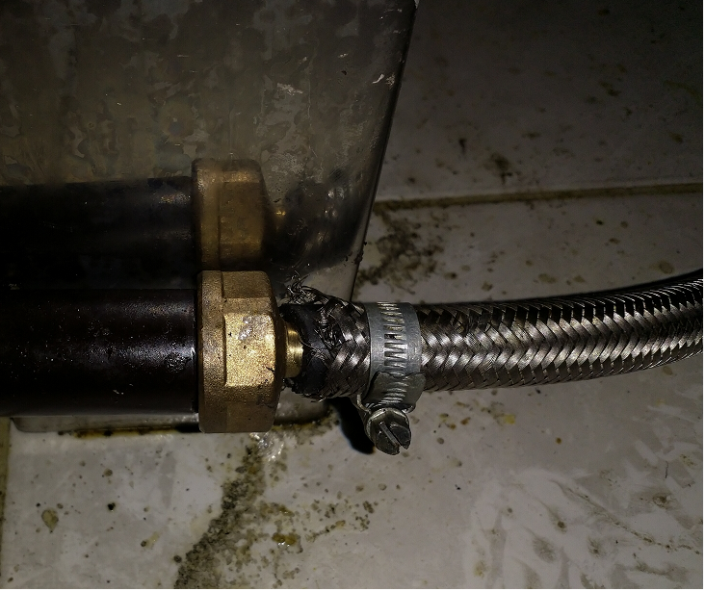
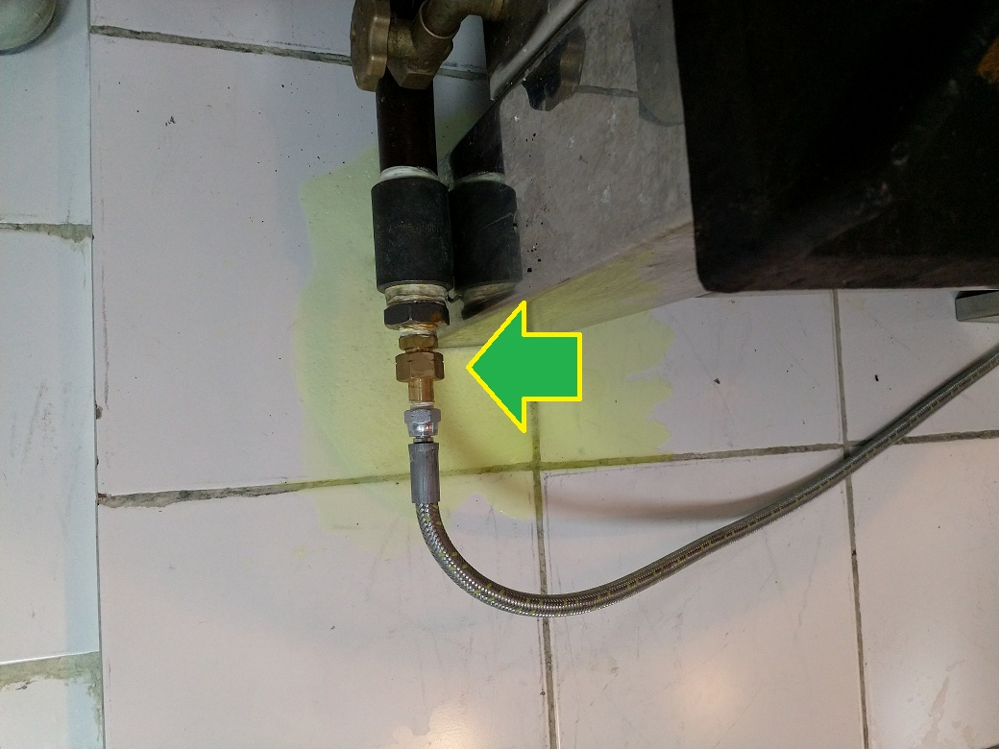
PDO Second Alert
Date: 26.06.2018 Incident title: LTI
What happened?
A gas supply hose connected to a kitchen burner became detached. The released gas ignited and the flames reached a Chapatti maker causing 3rd degree burns to 45% of his body.
Your learning from this incident..
Always ensure gas connections are fitted with threaded connections prior to starting cooking.
Always ensure installations are completed by competent staff.
Always ensure to do pre-checks before using the equipment.
Check equipment prior to start the job

Slide 2
Management self audit
Date: 26.06.2018 Incident title: LTI
As a learning from this incident and to ensure continual improvement all contract managers must review their HSE HEMP against the questions asked below
Confirm the following:
Do you ensure that periodic audits are conducted for the kitchen?
Do you ensure periodic checks for gas hoses, fixtures and fittings are carried out?
Do you ensure compliance with camp equipment installation / maintenance?
Do you ensure that competent supervisor s are assigned across HSE critical positions?
Notes:
Make a list of closed questions (only ‘yes’ or ‘no’ as an answer) to ask other contractors if they have the same issues based on the management or HSE-MS failings or shortfalls identified in the investigation. Pretend you have to audit other companies to see if they could have the same issues.

