Slide 1
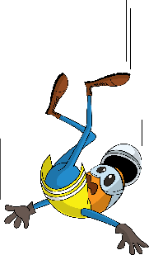
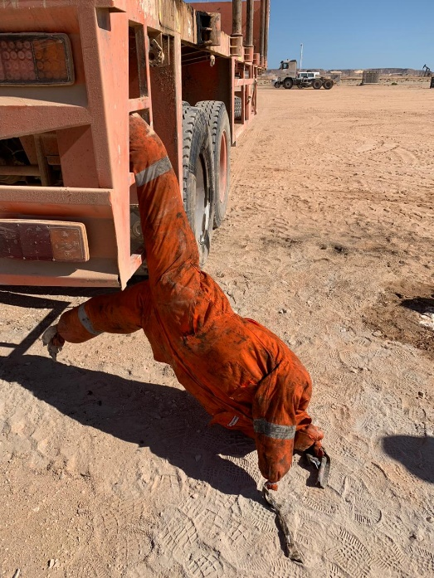
PDO Incident First Alert
Incident type | LTI (#27)
Date/ time | 12.11.2018 at 03:30hrs. | Directorate
Location | Marmul | Dept
What happened
While the Derrickman was climbing the trailer’s ladder, he slipped on the second step and got his right leg caught in between the ladder hanging approximately 1 meter above ground level. He was diagnosed with right knee soft tissue injuries.
Mr. Musleh asks the questions of can it happen to you?
Are you aware of all hazards that are identified in the task you performing?
Are you using 3 points of contacts techniques while climbing ladders?
Do you check that your boots are not slippery ?
Dummy used to reenact the position
Please disseminate this LTI notification to your teams and use it in your tool box talks and HSE meetings and notice boards.

