Slide 1
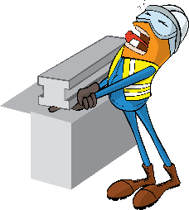
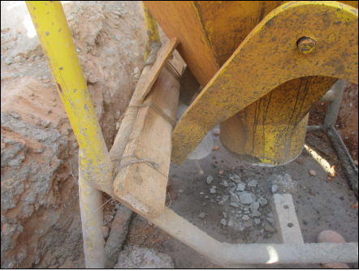
PDO Incident First Alert
Incident type | LTI (#29)
Date/ time | 28.11.2018 at 13:00hrs. | Directorate
Location | Harweel - Sakiya | Dept
What happened
While the carpenter was pulling the discharge latch of concrete pouring bucket, his right middle finger got trapped between the moving arm and fixed component of the concrete bucket. He was diagnosed with fractured right middle finger.
Mr. Musleh asks the questions of can it happen to you?
Are you aware of all hazards that are identified in the task you performing?
Are you in the ‘line of fire’?
Do you identify the pinch point?
The pinch point
Please disseminate this LTI notification to your teams and use it in your tool box talks and HSE meetings and notice boards.

