Slide 1
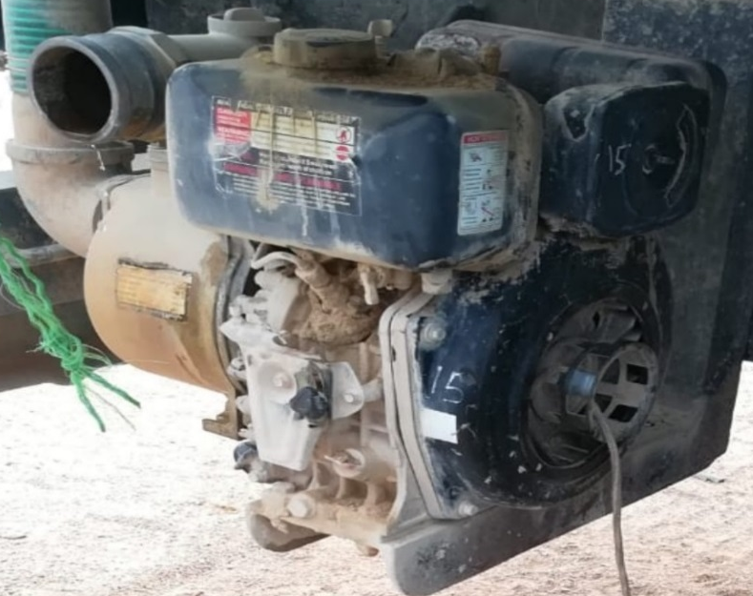
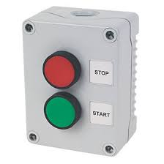
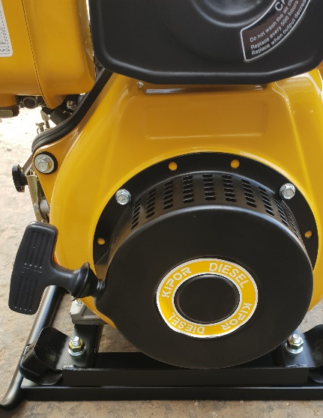
PDO Second Alert
Date: 01.07.2018 Incident type: LTI
What happened?
During the delivery of water to a local community location. A water tanker driver suffered finger injuries when he attempted to pull start the diesel generator water pump. The Driver attached the starter rope directly to the water pump flywheel notch and coiled the starter rope around his left hand while holding the starter handle with his right hand. On pulling the starter rope the rope failed to come free from the fly wheel which tensioned under force around his left hand coiled with the starter rope amputating his 4 fingers (index, middle ,ring & little fingers).
Your learning from this incident..
Ensure protective guards are in place on equipment
Always ensure equipment is full working condition and fit for use
Always Follow the Life Saving Rules
Make sure you always report defects to your supervisor
Use your empowerment to STOP
Always ensure protective guards are in place
Notes:
Ensure all dates and titles are input
A short description should be provided without mentioning names of contractors or individuals. You should include, what happened, to who (by job title) and what injuries this resulted in. Nothing more!
Four to five bullet points highlighting the main findings from the investigation. Remember the target audience is the front line staff so this should be written in simple terms in a way that everyone can understand.
The strap line should be the main point you want to get across
The images should be self explanatory, what went wrong (if you create a reconstruction please ensure you do not put people at risk) and below how it should be done.

Slide 2
Management self audit
Date: 01.07.2018 Incident type: LTI
As a learning from this incident and to ensure continual improvement all contract managers must review their HSE HEMP against the questions asked below
Confirm the following:
Do you ensure all items of moving machinery are adequately guarded?
Do you regularly communicate the PDO LSR’s with your workforce?
Do you ensure that you conduct regular task / worksite observations?
Do you encourage staff to use their empowerment to STOP?
Do you ensure audits include safety critical equipment?
* If the answer is NO to any of the above questions please ensure you take action to correct this finding.
Notes:
Ensure all dates and titles are input
Make a list of closed questions (only ‘yes’ or ‘no’ as an answer) to ask others if they have the same issues based on the management or HSE-MS failings or shortfalls identified in the investigation.
Imagine you have to audit other companies to see if they could have the same issues.
These questions should start with: Do you ensure…………………?

