Slide 1
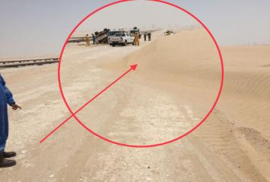
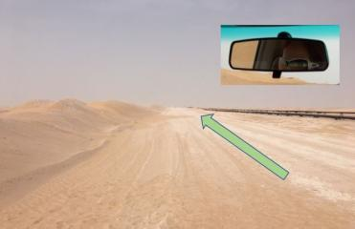
PDO Second Alert
Date: 04.08.2018 Incident title: HiPo MVI
What happened?
Crew consisting of 5 employees and the driver was travelling on 3Ton Canter to Anzuz site. Around 08:15 am, after crossing the Sahma station, the right tyre of the vehicle hit a sand dune on the graded road and driver lost control of the vehicle. The vehicle came to halt after rolling over.
Your learning from this incident..
Always report the road conditions at the earliest to the Journey Manager.
Always follow defensive driving techniques.
Always wear seat belt
Slow Down

Slide 2
Management self audit
Date: 04.08.2018 Incident title: HiPo MVI
As a learning from this incident and to ensure continual improvement all contract managers must review their HSE HEMP against the questions asked below
Confirm the following:
Do you ensure that accumulated sand (sand dune) is identified as a hazard in the HEMP
Do you ensure that all road hazards are communicated to the drivers
Do you ensure that IVMS data is analysed deeper than monitoring only the RAG Reports.
Do you report damaged (e.g. sand dunes) road conditions to the appropriate authorities.
* If the answer is NO to any of the above questions please ensure you take action to correct this finding.
Notes:
Ensure all dates and titles are input
Make a list of closed questions (only ‘yes’ or ‘no’ as an answer) to ask others if they have the same issues based on the management or HSE-MS failings or shortfalls identified in the investigation.
Imagine you have to audit other companies to see if they could have the same issues.
These questions should start with: Do you ensure…………………?

