Slide 1
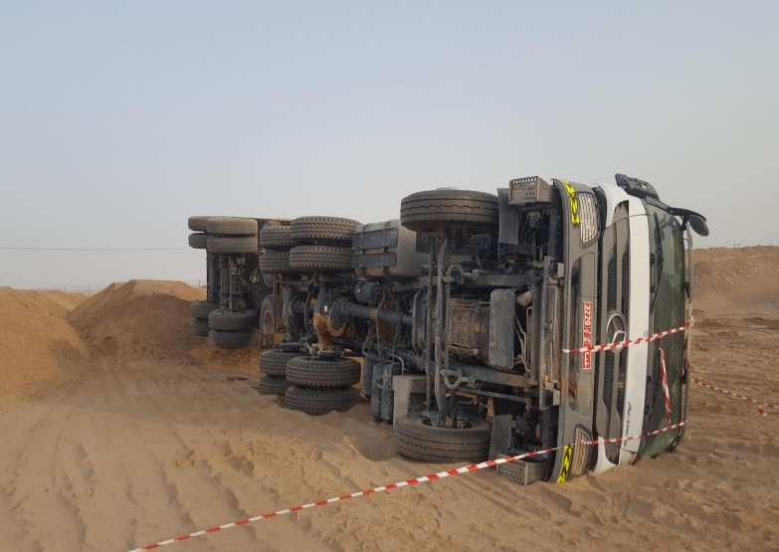
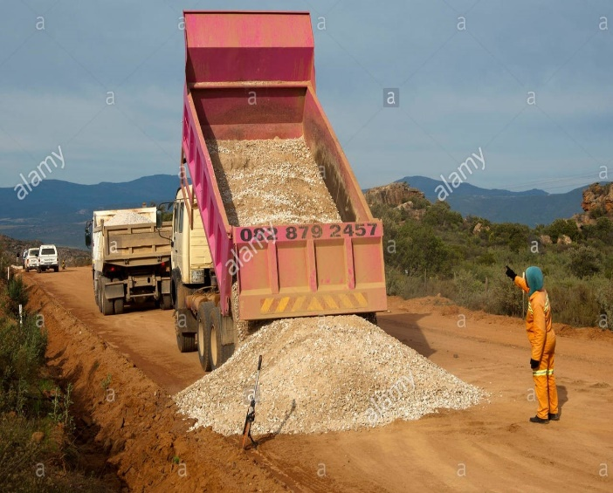
PDO Second Alert
Date: 07.08.2018 Incident title: MVI
What happened?
On the 7th August at approximately 07:10 while moving soil in the waste yard, during the tipping operation and at full tipper height the tipper toppled over and came to rest on its left hand side. (Driver side). No injury was sustained to the driver (or any persons standing / working close by) as a result of this incident.
Your learning from this incident..
Always ensure the truck is not overloaded.
Always ensure that the surface you are tipping onto firm enough and flat enough before tipping
Always ensure your Job Risk Assessment is up to date and adequate.
Always ensure banksman is used for vehicle movement, reversing and offloading materials.
You are always empowered to STOP if not Safe.
Your safety should always be built on SOLID ground
Notes:
Ensure all dates and titles are input
A short description should be provided without mentioning names of contractors or individuals. You should include, what happened, to who (by job title) and what injuries this resulted in. Nothing more!
Four to five bullet points highlighting the main findings from the investigation. Remember the target audience is the front line staff so this should be written in simple terms in a way that everyone can understand.
The strap line should be the main point you want to get across
The images should be self explanatory, what went wrong (if you create a reconstruction please ensure you do not put people at risk) and below how it should be done.

Slide 2
Management self audit
07.8.2018 Incident title: MVI
As a learning from this incident and to ensure continual improvement all contract
managers must review their HSE HEMP against the questions asked below
Confirm the following:
Do you ensure that tipping operations are covered in the HEMP?
Do you ensure that truck drivers are competent in tipping operations rather than just DD02 (heavy truck driving)?
Do you ensure extra training is provided rather than DD02?
Do you have influence in the recruitment of drivers by your sub contractors ?
Do you ensure that repetitive operations and risk normalization are issues that are managed/ controlled?
Do you ensure that you know the density of the material being transported, & so the total weight of the truck leaving your site?
* If the answer is NO to any of the above questions please ensure you take action to correct this finding.
Notes:
Ensure all dates and titles are input
Make a list of closed questions (only ‘yes’ or ‘no’ as an answer) to ask others if they have the same issues based on the management or HSE-MS failings or shortfalls identified in the investigation.
Imagine you have to audit other companies to see if they could have the same issues.
These questions should start with: Do you ensure…………………?

