Slide 1
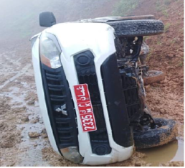
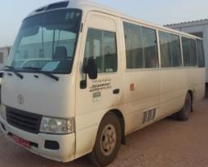
PDO Second Alert
Date: 27.08.2018 Incident type: HiPo MVI
What happened?
On the way to Salalah, the pick-up slid due to slippery
road which was wet and muddy during Kharif causing
the vehicle to trip over on its right side. Driver and
passenger were not injured.
Your learning from this incident..
Always use the right side of the road
Always wear seatbelt in a moving vehicle at all times
Always ensure to turn the vehicle’ lights on when visibility is poor
Adjust speed of vehicle according to road condition.

Slide 2
Management self audit
Date: 27.08.2018 Incident type: HiPo MVI
As a learning from this incident and to ensure continual improvement all contract
managers must review their HSE HEMP against the questions asked below
Confirm the following:
Do you ensure that assigned drivers are familiar with the route to Salalah during Kharif?
Do you communicate the hazards of thick for, wet and slippery roads during Kharif?
Do you instruct all drivers to reduce the speed according to road condition?
Do you instruct all drivers to use the slow (right) lane at the mountain area going to Salalah during Kharif?
Notes:
Make a list of closed questions (only ‘yes’ or ‘no’ as an answer) to ask other contractors if they have the same issues based on the management or HSE-MS failings or shortfalls identified in the investigation. Pretend you have to audit other companies to see if they could have the same issues.

