Slide 1
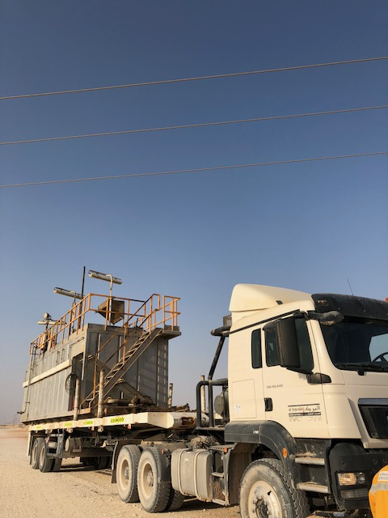
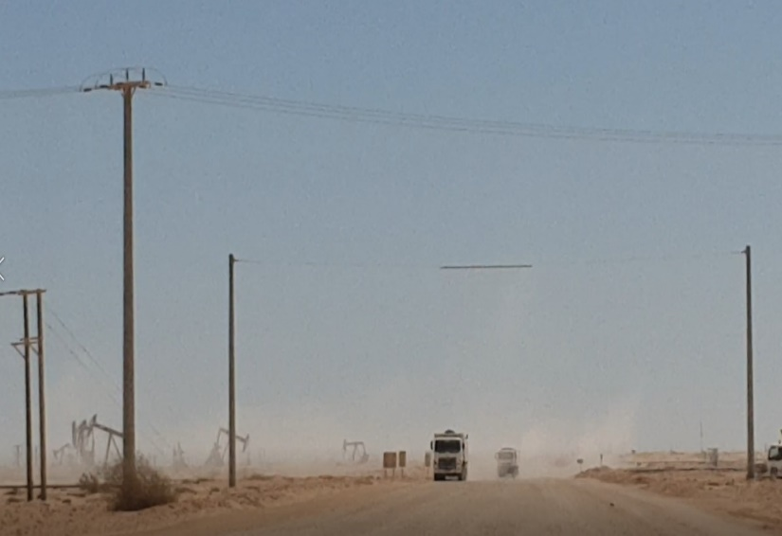
PDO Second Alert
Date: 27.09.2018 Incident title: HiPo OHL
What happened?
During the WPH72 move, driver was taking the circulation tank from the old to the new location. Prior to reaching the new location, the driver observed a electrical overhead line. He stopped just before the overhead line and attempted to lower the windsock pole which was projecting upwards. During the process the wind sock came within the electric field of the active electrical line and got electrocuted.
Your learning from this incident..
Always check for OHL during the route survey
Always follow the pre move, route survey checklist
Always use the roads with safety goal post while driving below an OHL
Always keep away from the Line of Fire
Do not drive underneath overhead lines without permission.
Notes:
Ensure all dates and titles are input
A short description should be provided without mentioning names of contractors or individuals. You should include, what happened, to who (by job title) and what injuries this resulted in. Nothing more!
Four to five bullet points highlighting the main findings from the investigation. Remember the target audience is the front line staff so this should be written in simple terms in a way that everyone can understand.
The strap line should be the main point you want to get across
The images should be self explanatory, what went wrong (if you create a reconstruction please ensure you do not put people at risk) and below how it should be done.

Slide 2
Management self audit
Date: 27.09.2018 Incident title: HiPo OHL
As a learning from this incident and to ensure continual improvement all contract
managers must review their HSE HEMP against the questions asked below
Confirm the following:
Do you ensure the team are following the route survey checklist.
Do you ensure implementation and assurance of learning from incidents.
Do you ensure OHL are identified during rig move route surveys.
Do you comply with the requirements of SP-1242 regarding work nearby overhead lines.
* If the answer is NO to any of the above questions please ensure you take action to correct this finding.
Notes:
Ensure all dates and titles are input
Make a list of closed questions (only ‘yes’ or ‘no’ as an answer) to ask others if they have the same issues based on the management or HSE-MS failings or shortfalls identified in the investigation.
Imagine you have to audit other companies to see if they could have the same issues.
These questions should start with: Do you ensure…………………?

