Slide 1
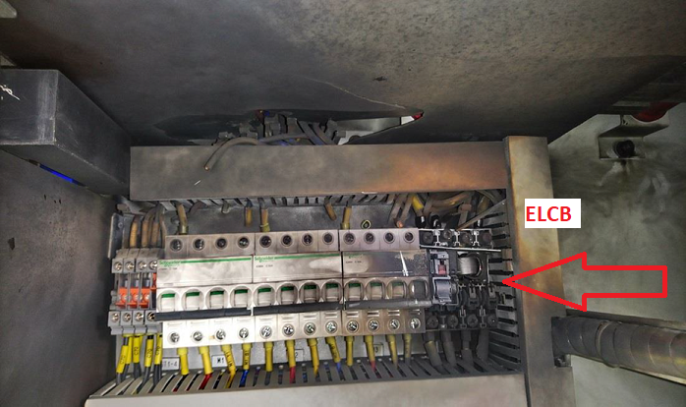
PDO Second Alert
Date: 09.09.2018 Incident title: Flashover HVL
What happened?
A team (Supervisor & Technician) entered the BMF LV panel Area for continuity test with No Permit Job (NPJ). As per NPJ team has to work on conduit fixing and light fixtures. Site Supervisor and the technician opened the LV panel for checking continuity and decided to power up the lighting circuit which is not included in the NPJ. To power up the lighting circuits, the technician switched on 32A ELCB in the same panel without checking for confirmation of its respective outgoing cables. The moment he turned on the 32A ELCB the electrical flash over occurred.
Your learning from this incident..
Always follow Permit to Work Systems must be followed
Always make sure you are competent to do the job.
Always ensure to not access restricted areas without authorization.
Always ensure isolation is verified prior to applying additional earthing
Always get authorization before starting any job!
Notes:
Ensure all dates and titles are input
A short description should be provided without mentioning names of contractors or individuals. You should include, what happened, to who (by job title) and what injuries this resulted in. Nothing more!
Four to five bullet points highlighting the main findings from the investigation. Remember the target audience is the front line staff so this should be written in simple terms in a way that everyone can understand.
The strap line should be the main point you want to get across
The images should be self explanatory, what went wrong (if you create a reconstruction please ensure you do not put people at risk) and below how it should be done.

Slide 2
Management self audit
16th August 2018: Electrical Flashover leads Asset damage & MTC
As a learning from this incident and ensure continual improvement all contract
managers must review their HSE HEMP against the questions asked below
Confirm the following:
Do you ensure All access to restricted areas are controlled with PTW as per PR1172?
Do you ensure adequate and competent supervision is in place for high risk activities, and that CEP authorized persons are readily available to comply with PDO ESR?
Do you ensure all staff have a good awareness and comply with the PTW process?
Do you ensure all staff understand the hazards and consequences of working on Energized Electrical Equipment?
Do you ensure all staff are fully aware of what to do in an emergency situation and are aware of the PDO emergency numbers?
Notes:
Ensure all dates and titles are input
Make a list of closed questions (only ‘yes’ or ‘no’ as an answer) to ask others if they have the same issues based on the management or HSE-MS failings or shortfalls identified in the investigation.
Imagine you have to audit other companies to see if they could have the same issues.
These questions should start with: Do you ensure…………………?

