Slide 1
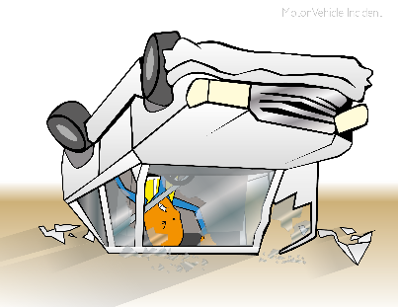
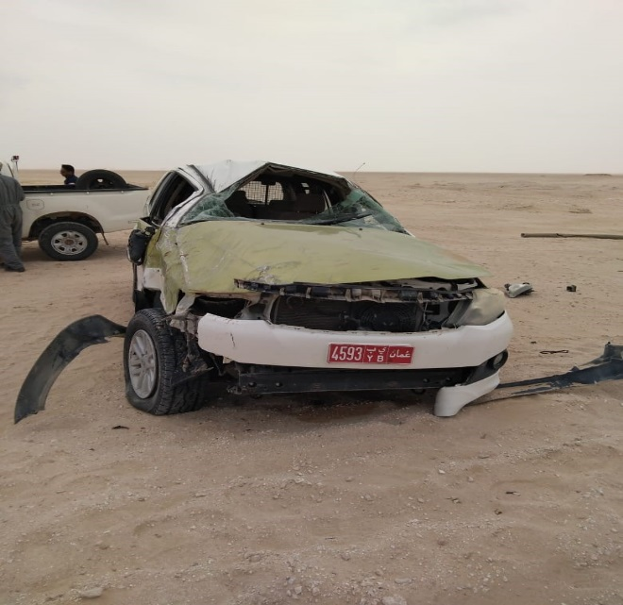
PDO Incident First Alert
Incident type | LTI (#05)
Date/ time | 24.03.19 @14:00hrs | Directorate
Location | Qarn Alam | Dept
What happened
While the driver was traveling to Mabrouk on graded road, he lost control of the vehicle resulting in a roll-over. The driver had multiple injuries and a fracture in his back.
Mr. Musleh asks the questions of can it happen to you?
Do you always adjust your speed according to road condition?
Do you always apply defensive driving techniques?
Do you always ensure you and passengers wear seatbelts?
Please disseminate this LTI notification to your teams and use it in your tool box talks and HSE meetings and notice boards.

