Slide 1
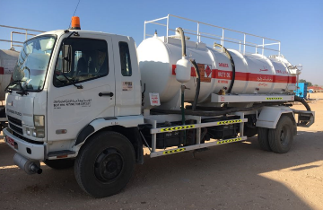
PDO Second Alert
Date: 09.10.2018 Incident title: HiPo (NORM)
What happened?
On 08 and 09 October 2018 a PTW Holder loosened a T- tank’s D-door of a NORM tank, drained oily liquid and got it transported by a third party vacuum tanker to PDO NORM yard. The incident was noted on 09 October and reported to PDO management.
Your learning from this incident:
Only PDO approved specialist contractor is allowed to handle and transport NORM.
Contractor site management shall ensure that PTW Holders have enough time and correct resources to deal with NORM tanks.
Always follow NORM protocol!
Notes:
Ensure all dates and titles are input
A short description should be provided without mentioning names of contractors or individuals. You should include, what happened, to who (by job title) and what injuries this resulted in. Nothing more!
Four to five bullet points highlighting the main findings from the investigation. Remember the target audience is the front line staff so this should be written in simple terms in a way that everyone can understand.
The strap line should be the main point you want to get across
The images should be self explanatory, what went wrong (if you create a reconstruction please ensure you do not put people at risk) and below how it should be done.

Slide 2
Management self audit
Date: 09-10-2018 Incident title: HiPo (NORM)
As a learning from this incident and ensure continual improvement all contract
managers must review their HSE HEMP against the questions asked below
Confirm the following:
Do you ensure you use only PDO approved specialist contractor to handle and transport NORM?
Do you conduct regular NORM awareness sessions for your workforce who are involved in activities where NORM are present?
Do you ensure your site management know the scope of dealing with NORM and do not take the shortcuts to speed up a task?
Do you ensure that relevant staff have clarity on how to handle Liquid and Solid sludge from Norm Classified source.
* If the answer is NO to any of the above questions please ensure you take action to correct this finding.
Notes:
Ensure all dates and titles are input
Make a list of closed questions (only ‘yes’ or ‘no’ as an answer) to ask others if they have the same issues based on the management or HSE-MS failings or shortfalls identified in the investigation.
Imagine you have to audit other companies to see if they could have the same issues.
These questions should start with: Do you ensure…………………?

