Slide 1
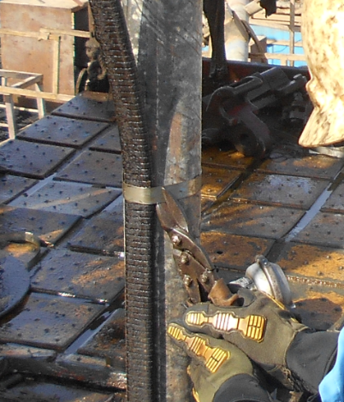
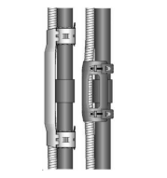
PDO Second Alert
Date: LTI # 26, ESP Cable Slip – Arm Fracture
What happened?
While checking the cable reading after N/D BOP it was found to be negative. Decided to POOH the tubing hanger. While POOH, found that the cable was partially disconnected from the PFT lower connector. The cable reading was checked again after removing the PFT and it was found positive. So decided to lay down one joint and cut the cable to reconnect PFT connecter and land HGR. POOH and lay down HGR+1 joint . Started POOH the second joint and while removing the second band from the cable, it slipped very quickly into the well and during the process the cable wagged and it hit the derrickman on his left arm causing fracture.
Your learning from this incident..
Always suspect tension on the cable if it is found disconnected from the PFT connector.
Always ensure that only competent personnel does the banding on the ESP cable.
Use clamps instead on bands
Use clamps instead of bands to secure ESP cable on the tubing
Notes:
Ensure all dates and titles are input
A short description should be provided without mentioning names of contractors or individuals. You should include, what happened, to who (by job title) and what injuries this resulted in. Nothing more!
Four to five bullet points highlighting the main findings from the investigation. Remember the target audience is the front line staff so this should be written in simple terms in a way that everyone can understand.
The strap line should be the main point you want to get across
The images should be self explanatory, what went wrong (if you create a reconstruction please ensure you do not put people at risk) and below how it should be done.

Slide 2
Management self audit
Date: 25.10.2018 Incident title – ESP cable slip, Arm fracture
As a learning from this incident and ensure continual improvement all contract
managers must review their HSE HEMP against the questions asked below
Confirm the following:
Do you ensure your employee check that ESP is not under tension during POOH
Do you ensure competent employee carry out banding of ESP cable
Do you ensure roles and responsibilities are clearly defined and understood among the Hoist crew and the ESP crew.
Do you ensure a formal handover between the ESP crew leads.
Due you ensure the availability and application of the MoC procedure during ESP installation.
* If the answer is NO to any of the above questions please ensure you take action to correct this finding.
Notes:
Ensure all dates and titles are input
Make a list of closed questions (only ‘yes’ or ‘no’ as an answer) to ask others if they have the same issues based on the management or HSE-MS failings or shortfalls identified in the investigation.
Imagine you have to audit other companies to see if they could have the same issues.
These questions should start with: Do you ensure…………………?

