Slide 1
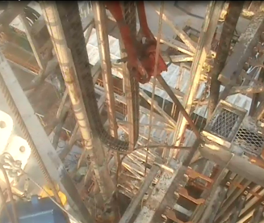
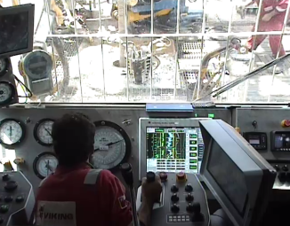
PDO Second Alert
Date: 15th March 2019 Incident title: HiPo#12 Bent Pipe
What happened?
Operation was RIH 2 7/8” drill pipe doubles. After picking-up stand number 39 with the elevator, while lowering the stand with the TDS to make the connection, the stand was stabbed into the joint in the table. The driller pushed the joy stick throttle on high rev causing the TDS to descend with speed. The sudden speed & weight from the TDS hitting the top tool joint causing the stand to bend.
Learnings
Always ensure to operate the hoisting equipment at a safe speed
Pay attention to what you are doing when operating equipment
Always use the correct buttons and switches
Always be alert and operate drilling hoisting equipment at safe speed.
Notes:
Ensure all dates and titles are input
A short description should be provided without mentioning names of contractors or individuals. You should include, what happened, to who (by job title) and what injuries this resulted in. Nothing more!
Four to five bullet points highlighting the main findings from the investigation. Remember the target audience is the front line staff so this should be written in simple terms in a way that everyone can understand.
The strap line should be the main point you want to get across
The images should be self explanatory, what went wrong (if you create a reconstruction please ensure you do not put people at risk) and below how it should be done.

Slide 2
Management self audit
Date: 15th March 2019 Incident title: HiPo#12 Bent Pipe
As a learning from this incident and ensure continual improvement all contract
managers must review their HSE HEMP against the questions asked below
Confirm the following:
Have your organization possess a comprehensive frame work competency program ?
Do you perform competency compliance check for workforce on regular basis?
Do you follow a systematic hazard analysis approach when installing or acquiring new equipment?
Do you assure your competency framework against international standards ?
Does your organization have an effective controls for contractors and supplier vendors management ?
Do You review SWP/SOP/OEM against existing JSA ‘s?
* If the answer is NO to any of the above questions please ensure you take action to correct this finding.
Notes:
Ensure all dates and titles are input
Make a list of closed questions (only ‘yes’ or ‘no’ as an answer) to ask others if they have the same issues based on the management or HSE-MS failings or shortfalls identified in the investigation.
Imagine you have to audit other companies to see if they could have the same issues.
These questions should start with: Do you ensure…………………?

