Slide 1
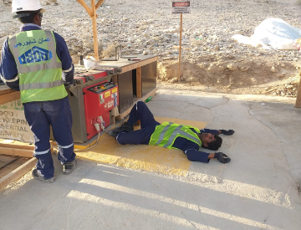
PDO Second Alert
Date: 07.03.2019 Incident title: LTI
What happened?
While working on rebar bending activity at the steel workshop , the steel fixer felt dizziness then fainted and fell to the ground striking his head on the floor causing hairline occipital bone fracture.
Your learning from this incident.
Report any illness to your supervisor and HSE Team, prior to start of task.
Never skip your meals .
Supervisor to ensure all employees are reporting any concerns
Individuals to understand that health comes before work
Stop work immediately and report if injured or sick
Communicate about health issues during TBT.
Skipping MEAL , can make you ILL
Notes:
Ensure all dates and titles are input
A short description should be provided without mentioning names of contractors or individuals. You should include, what happened, to who (by job title) and what injuries this resulted in. Nothing more!
Four to five bullet points highlighting the main findings from the investigation. Remember the target audience is the front line staff so this should be written in simple terms in a way that everyone can understand.
The strap line should be the main point you want to get across
The images should be self explanatory, what went wrong (if you create a reconstruction please ensure you do not put people at risk) and below how it should be done.

Slide 2
Management self audit
Date:07.03.2019 Incident title: LTI No:4
As a learning from this incident and ensure continual improvement all contract
managers must review their HSE HEMP against the questions asked below
Confirm the following:
Do you ensure all employees are asked about their fitness prior to start of work?
Do you ensure employees report about their illness and any other concerns to their supervisor.?
Do you ensure your employees follow a healthy living habits?
Do you ensure your employees are empowered to stop?
Do you ensure that your supervision is effective?
Do you ensure Health issues are communicated in your TBT?
* If the answer is NO to any of the above questions please ensure you take action to correct this finding.
Notes:
Ensure all dates and titles are input
Make a list of closed questions (only ‘yes’ or ‘no’ as an answer) to ask others if they have the same issues based on the management or HSE-MS failings or shortfalls identified in the investigation.
Imagine you have to audit other companies to see if they could have the same issues.
These questions should start with: Do you ensure…………………?

