Slide 1
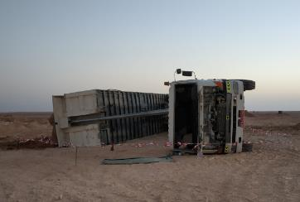
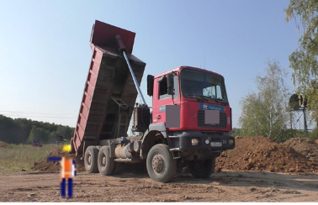
PDO Second Alert
Date: 17 Feb 2019 Incident title: HiPo Tip over
What happened?
An articulated tipper while unloading soil by lifting the hydraulic cylinder ram, due to the uneven surface condition and wet soil accumulated on the right side top end, the tipper tipped over to its right.
Your learning from this incident..
Always ensure soil is in dry condition before loading and transportation.
Always ensure the ground condition is compacted and leveled before parking and unloading.
Always ensure while moving the tipper the hydraulic ram of tipper is not extended.
Check wind conditions are suitable for unloading.
Always ensure right conditions before unloading
Notes:
Ensure all dates and titles are input
A short description should be provided without mentioning names of contractors or individuals. You should include, what happened, to who (by job title) and what injuries this resulted in. Nothing more!
Four to five bullet points highlighting the main findings from the investigation. Remember the target audience is the front line staff so this should be written in simple terms in a way that everyone can understand.
The strap line should be the main point you want to get across
The images should be self explanatory, what went wrong (if you create a reconstruction please ensure you do not put people at risk) and below how it should be done.

Slide 2
Management self audit
Date: 17 Feb 2019 Incident title: HiPo Tip over
As a learning from this incident and ensure continual improvement all contract
managers must review their HSE HEMP against the questions asked below
Confirm the following:
Do you ensure that while loading excavated soil it is in dry condition?
Do you ensure Borrow pit unloading area is properly leveled and compacted?
Do your supervisor visit site before applying the permit to see the site conditions?
Do you ensure that PA is explaining about permit condition with all appropriate control measures to PH and site crew?
Do you ensure tipper driver does not move tipper when RAM is in extended position?
Do you ensure that 36 m3 tippers are not operated for PDO operations?
* If the answer is NO to any of the above questions please ensure you take action to correct this finding.
Notes:
Ensure all dates and titles are input
Make a list of closed questions (only ‘yes’ or ‘no’ as an answer) to ask others if they have the same issues based on the management or HSE-MS failings or shortfalls identified in the investigation.
Imagine you have to audit other companies to see if they could have the same issues.
These questions should start with: Do you ensure…………………?

