Slide 1
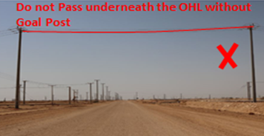
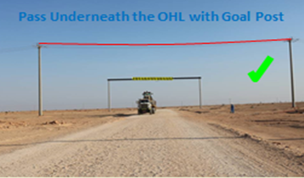
PDO Second Alert
Date: 24th August 2019 HiPo#50
What happened?
During infield move a brine tank was loaded on the winch truck trailer. After loading, the driver decided to follow an Oilfield to the new location. The Oilfield truck took a left turn deviating from the surveyed route and the Brine Tank driver followed after approx. 200 meters from the turning, the pole light on top of the Brine Tank contacted the 33 kV Over Head Power Line entangling it and dragging the power line for 30 meters resulting in the breakage of 5 supporting utility poles. No Injury to driver.
Your learning from this incident..
Deviating from your route can lead to unforeseen hazards
Always travel on the surveyed route with No deviation.
Do not access route having power lines without goal posts and safety barriers.
Always follow convoy procedures.
Do not pass underneath OHL without Goal Post.
Notes:
Ensure all dates and titles are input
A short description should be provided without mentioning names of contractors or individuals. You should include, what happened, to who (by job title) and what injuries this resulted in. Nothing more!
Four to five bullet points highlighting the main findings from the investigation. Remember the target audience is the front line staff so this should be written in simple terms in a way that everyone can understand.
The strap line should be the main point you want to get across
The images should be self explanatory, what went wrong (if you create a reconstruction please ensure you do not put people at risk) and below how it should be done.

Slide 2
Management self audit
Date: 24th August 2019 HiPo#50
As a learning from this incident and ensure continual improvement all contract
managers must review their HSE HEMP against the questions asked below
Confirm the following:
Do you ensure the Rig move team are following the route survey.
Do you ensure the IVMS for route deviation in After Action Review?
Do you ensure supervisors move oversized load in convoy?
Do you ensure IVMS for route compliance for Rig move?
Do you ensure a robust system to control deviation from the approved route?
Do you ensure all hazards are included in risk assessments and TBT’s?
* If the answer is NO to any of the above questions please ensure you take action to correct this finding.
Notes:
Ensure all dates and titles are input
Make a list of closed questions (only ‘yes’ or ‘no’ as an answer) to ask others if they have the same issues based on the management or HSE-MS failings or shortfalls identified in the investigation.
Imagine you have to audit other companies to see if they could have the same issues.
These questions should start with: Do you ensure…………………?

