Slide 1
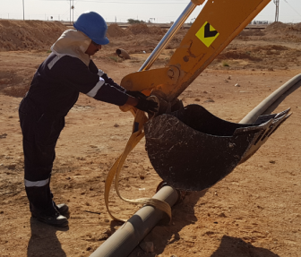
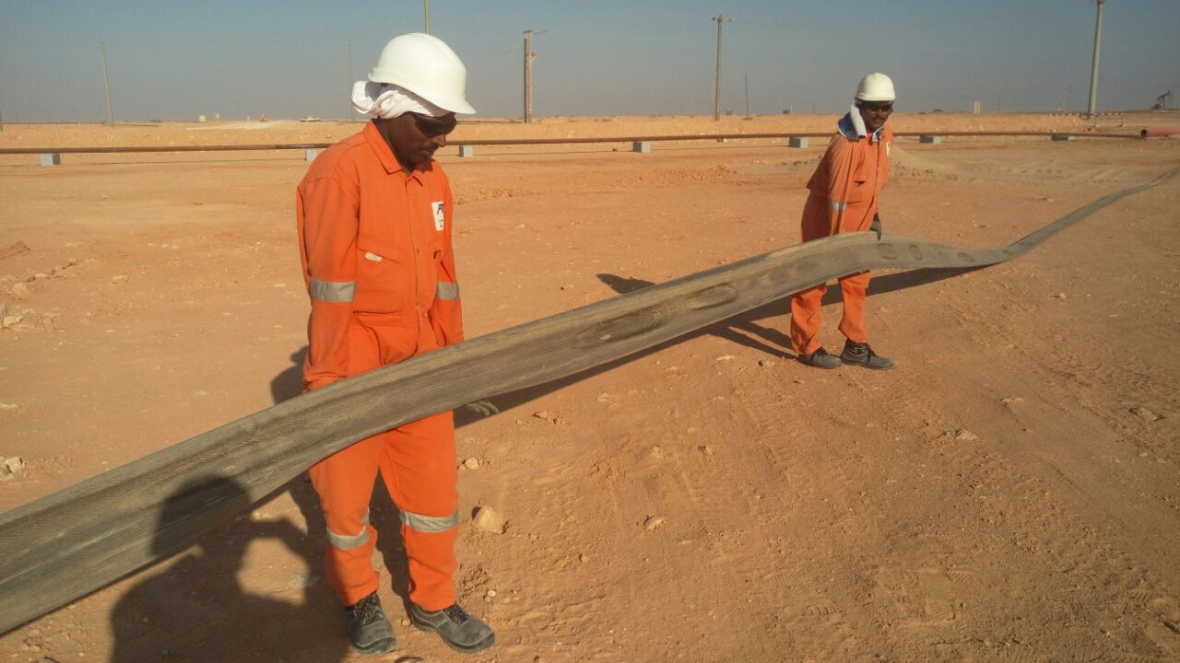
PDO Second Alert
Date: 29.11.2017 Incident: LTI
What happened?
While connecting a web sling to an excavator bucket, the helper’s left hand little finger got trapped between the web sling and the bucket pivot pin resulting in a fracture to his little finger.
Your learning from this incident..
Use the right tool for the job and use them correctly
Always stay away from moving parts of equipment
Conduct Dynamic risk assessment when ever there is a
change in site conditions
Always understand the job requirement or find out
Follow Management of Change for an activity which is not in permit
Stable platform

Slide 2
Management self audit
Date: 29.11.2017 Incident: LTI
As a learning from this incident and ensure continual improvement all contract
managers must review their HSE HEMP against the questions asked below
Confirm the following:
Do you ensure all pulling and shifting activities are identified in HEMP?
Do you ensure that competent personnel are assigned to the job?
Do you ensure supervision for the job at all times?
Do You ensure that your staff are authorized to carry out the task?
Notes:
Make a list of closed questions (only ‘yes’ or ‘no’ as an answer) to ask other contractors if they have the same issues based on the management or HSE-MS failings or shortfalls identified in the investigation. Pretend you have to audit other companies to see if they could have the same issues.

