Slide 1
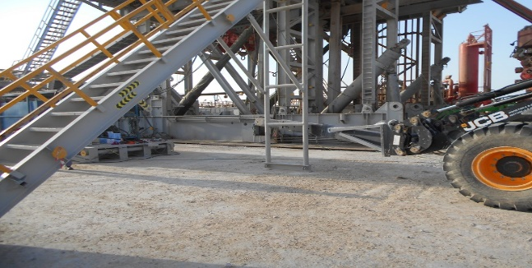
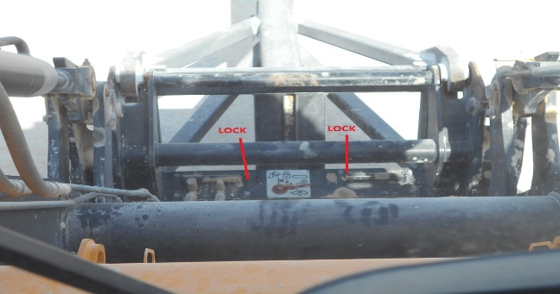
PDO Second Alert
Date: 3rd April 2019 Incident title: HiPo#23
What happened?
At 10:15am on 3rd April, the operation was to rig down in preparation for rig move. The forklift was used to push the support bracket of the rig floor ladder in order to fold it. As soon as the forklift’s boom touched the bracket, the boom fell to the ground from a height of approximately 1m. No injury or asset damage were sustained.
Your learning from this incident.
Ensure forklift boom/fork is locked after installation through the hydraulic lock handle in the operator’s cabin.
Ensure Before lifting operations, operator is checking the lock status of the lock pin by observing the position of the two lock indication bars.
Do not use forklift boom to side-push load.
Lock engaged
No body shall stay in No-Go Zone!
Notes:
Ensure all dates and titles are input
A short description should be provided without mentioning names of contractors or individuals. You should include, what happened, to who (by job title) and what injuries this resulted in. Nothing more!
Four to five bullet points highlighting the main findings from the investigation. Remember the target audience is the front line staff so this should be written in simple terms in a way that everyone can understand.
The strap line should be the main point you want to get across
The images should be self explanatory, what went wrong (if you create a reconstruction please ensure you do not put people at risk) and below how it should be done.

Slide 2
Management self audit
Date: 3rd April 2019 Incident title: HiPo#23
As a learning from this incident and ensure continual improvement all contract
managers must review their HSE HEMP against the questions asked below
Confirm the following:
Do you ensure that your HEMP covers all risks of lifting operation?
Do you ensure that your supervisor is competent enough for the operation?
Do you ensure your subcontractor’s equipment are safe and proper to operate?
Do you ensure that you are using the right tool for the job?
* If the answer is NO to any of the above questions please ensure you take action to correct this finding.
Notes:
Ensure all dates and titles are input
Make a list of closed questions (only ‘yes’ or ‘no’ as an answer) to ask others if they have the same issues based on the management or HSE-MS failings or shortfalls identified in the investigation.
Imagine you have to audit other companies to see if they could have the same issues.
These questions should start with: Do you ensure…………………?

