Slide 1
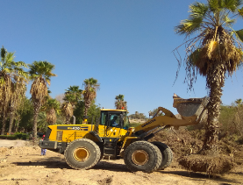
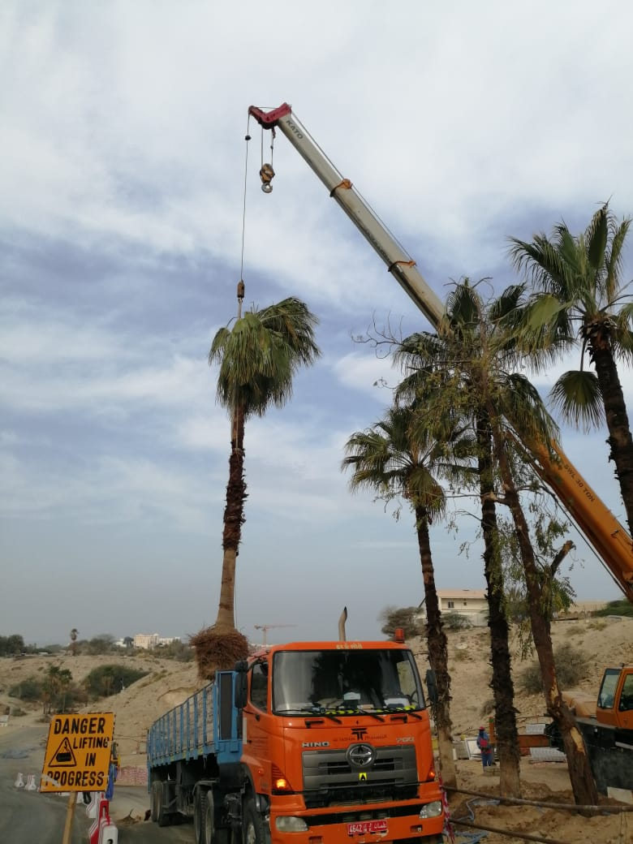
PDO Second Alert
Date: 23rd March 2019 Incident : HiPo#44
What happened?
While doing the tree replanting activity the shovel operator lost control of the shovel due to the uneven surface and toppled to the right side of the backhoe loader. Both the operator (shovel and the Backhoe Loader) was able to vacate from the opposite side door of the machine without any injuries.
Your learning from this incident..
Always operate as per the ground conditions.
Always provide competent supervision for the job.
Always deploy experienced and competent operator.
Always plan the activity with adequate resources.
Always ensure that equipment is operated on even ground conditions.
Ensure the right equipment is used to carry out the activity
Notes:
Ensure all dates and titles are input
A short description should be provided without mentioning names of contractors or individuals. You should include, what happened, to who (by job title) and what injuries this resulted in. Nothing more!
Four to five bullet points highlighting the main findings from the investigation. Remember the target audience is the front line staff so this should be written in simple terms in a way that everyone can understand.
The strap line should be the main point you want to get across
The images should be self explanatory, what went wrong (if you create a reconstruction please ensure you do not put people at risk) and below how it should be done.

Slide 2
Management self audit
Date: 23rd March 2019 Incident : HiPo#44
As a learning from this incident and ensure continual improvement all contract
managers must review their HSE HEMP against the questions asked below
Confirm the following:
Do you ensure all your employees are experienced and competent to carryout the task?.
Do you ensure that your activities are planned ?
Do you ensure that the competent supervision has been provided for the job ?
Do you ensure that TBT are conducted for every activities ?
Do you ensure that all the safe procedures are being followed ?
* If the answer is NO to any of the above questions please ensure you take action to correct this finding.
Notes:
Ensure all dates and titles are input
Make a list of closed questions (only ‘yes’ or ‘no’ as an answer) to ask others if they have the same issues based on the management or HSE-MS failings or shortfalls identified in the investigation.
Imagine you have to audit other companies to see if they could have the same issues.
These questions should start with: Do you ensure…………………?

