Slide 1
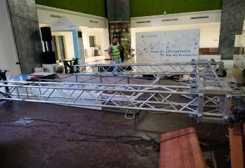
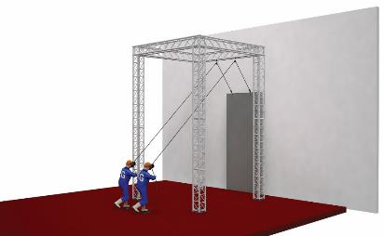
PDO Second Alert
Date: 02nd Apr 2019 Incident–HiPo#28
What happened?
While dismantling the event backdrop, truss lost its balance and collapsed leading to damage of a Wooden bench. No personnel were injured.
Learnings from incident:
TBTs and Safety Meeting documentation is a must
Always carryout a Risk Assessment of the job
Always conduct a Pre Execution safety inspection to understand the site conditions
Always ensure that an approved lift plan is shared with the crew
Need of having a proper Lifting Plan as per PDO standards
Follow the approved Lifting plan
Notes:
Ensure all dates and titles are input
A short description should be provided without mentioning names of contractors or individuals. You should include, what happened, to who (by job title) and what injuries this resulted in. Nothing more!
Four to five bullet points highlighting the main findings from the investigation. Remember the target audience is the front line staff so this should be written in simple terms in a way that everyone can understand.
The strap line should be the main point you want to get across
The images should be self explanatory, what went wrong (if you create a reconstruction please ensure you do not put people at risk) and below how it should be done.

Slide 2
Management self audit
Date: 02nd Apr 2019 Incident title-HiPo#28
As a learning from this incident and ensure continual improvement all contract managers must review their HSE HEMP against the questions asked below
Confirm the following:
Do you ensure competency checks for sub contractor employees deployed on critical tasks ?
Do you ensure the TBTs are interactive and covers all relevant hazards for the tasks in hand ?
Do you ensure you have risk assessment (and approved lift plans as required) for all tasks ?
Do you ensure that your contractor understands the mode of contract and is applicable to the required Scope of Work?

