Slide 1
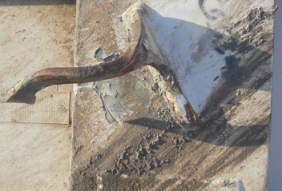
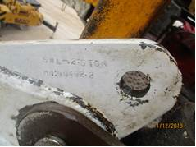
PDO Second Alert
Date: Oct 8th, 2019 Incident: HIPO #61 Equipment Damage
What happened?
A crane operator was attempting to lower the V-door to the cat walk deck. The V-door was in the lowering phase. It was over to approximately a 60 degree angle, height around 3.4m high above the catwalk deck when the two pad eyes on either side of the v-door being used failed (torn open). The V-door free fell to the catwalk deck.
Your learning from this incident..
Prior to any lift really check your equipment and points you lift from
Confirm that all Pad Eyes are in the register and have valid certification
ensure using one tracking for all lifting equipment's ( One system ) to be used for all equipment management
If it does not look right it is your right and responsibility to inform management
Ensure pad eyes are inspected and color coded prior lifting
Notes:
Ensure all dates and titles are input
A short description should be provided without mentioning names of contractors or individuals. You should include, what happened, to who (by job title) and what injuries this resulted in. Nothing more!
Four to five bullet points highlighting the main findings from the investigation. Remember the target audience is the front line staff so this should be written in simple terms in a way that everyone can understand.
The strap line should be the main point you want to get across
The images should be self explanatory, what went wrong (if you create a reconstruction please ensure you do not put people at risk) and below how it should be done.

Slide 2
Management self audit
Date: 03 October 2019 Incident title: Dropped V DOOR
As a learning from this incident and ensure continual improvement all contract
managers must review their HSE HEMP against the questions asked below
Confirm the following:
Do you ensure a confirmed list of all pad eyes on the rig to be inspected by 3rd party?
Do you ensure a method to confirm that all equipment is inspected at the time of a lift?
Do you ensure a method to ensure that all pad eyes are actually in your register?
Do You ensure method to ensure proper commissioning gaps is being carried out ?
* If the answer is NO to any of the above questions please ensure you take action to correct this finding.
Notes:
Ensure all dates and titles are input
Make a list of closed questions (only ‘yes’ or ‘no’ as an answer) to ask others if they have the same issues based on the management or HSE-MS failings or shortfalls identified in the investigation.
Imagine you have to audit other companies to see if they could have the same issues.
These questions should start with: Do you ensure…………………?

