Slide 1
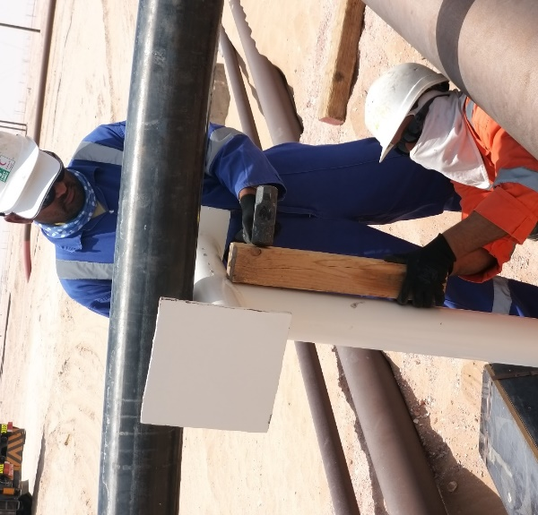
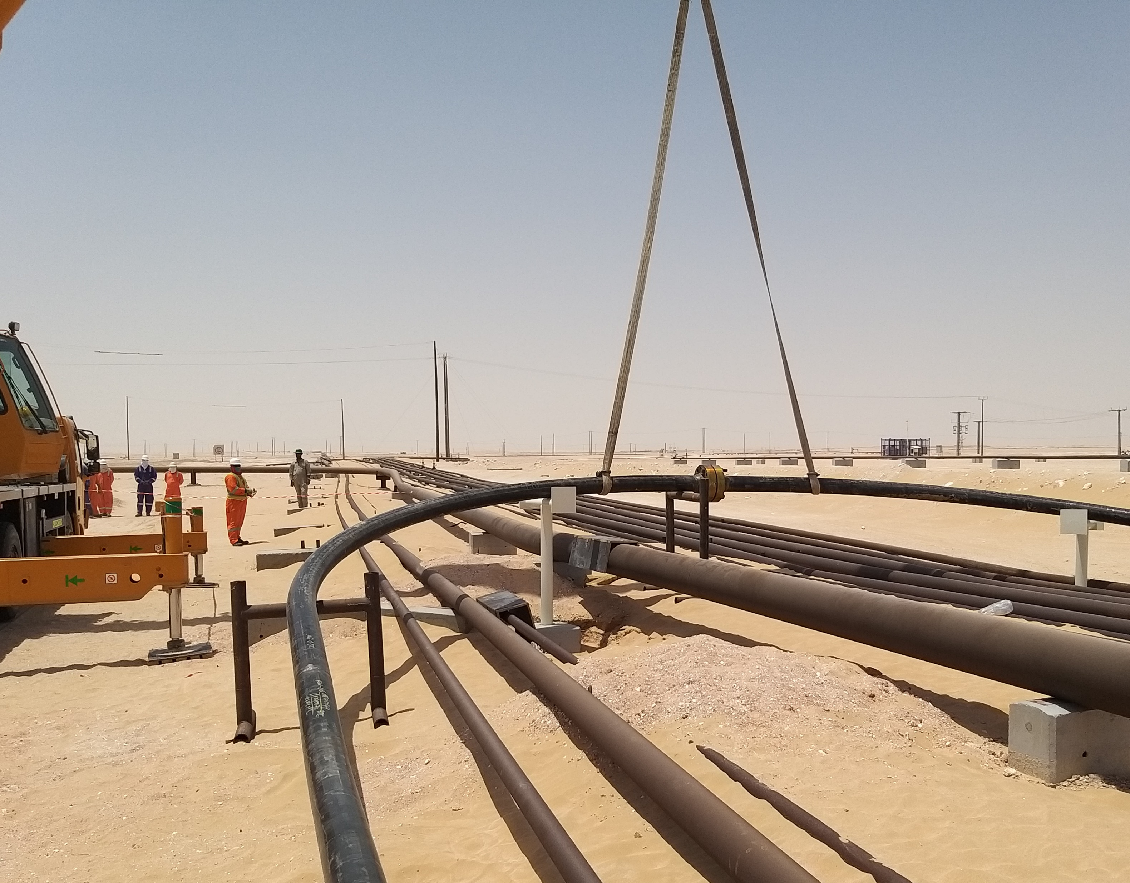
PDO Second Alert
Date: 07.07.2019 Incident title: LTI # 07, Finger fracture
What happened?
Civil crew while aligning the pipe support manually by using hammer and wooden batten, While hammering, the Mason’s left hand index and middle finger inadvertently got trapped between the pipe support structure and the wooden batten resulting in a deep lacerated injury.
Your learning from this incident..
Always ensure that your body parts are clear from the line of fire.
Always ensure appropriate resources are available at site prior commencement of activity.
Always conduct Dynamic Risk Assessment when you observe change in site conditions.
Always exercise “ Empowerment to Stop Unsafe act”
Always keep your body parts away from Pinch points.
Notes:
Ensure all dates and titles are input
A short description should be provided without mentioning names of contractors or individuals. You should include, what happened, to who (by job title) and what injuries this resulted in. Nothing more!
Four to five bullet points highlighting the main findings from the investigation. Remember the target audience is the front line staff so this should be written in simple terms in a way that everyone can understand.
The strap line should be the main point you want to get across
The images should be self explanatory, what went wrong (if you create a reconstruction please ensure you do not put people at risk) and below how it should be done.

Slide 2
Management self audit
Date: 07.07.2019 Incident title: Incident title: LTI # 7, Finger Fracture
As a learning from this incident and ensure continual improvement all contract
managers must review their HSE HEMP against the questions asked below
Confirm the following:
Do you ensure that change in work plan is communicated to all stake holders?
Do you ensure that the activities are planned with appropriate resources?
Do you ensure that your method statements/ procedures are updated on timely basis?
Do your supervisor visits site before applying the permit to see the site conditions?
Do your Supervisor explain about PTW requirements with appropriate control measures at site?
* If the answer is NO to any of the above questions please ensure you take action to correct this finding.
Notes:
Ensure all dates and titles are input
Make a list of closed questions (only ‘yes’ or ‘no’ as an answer) to ask others if they have the same issues based on the management or HSE-MS failings or shortfalls identified in the investigation.
Imagine you have to audit other companies to see if they could have the same issues.
These questions should start with: Do you ensure…………………?

