Slide 1
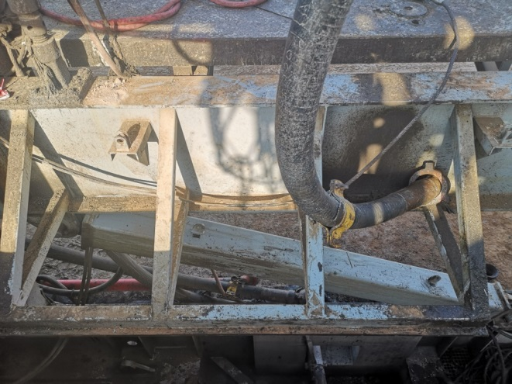
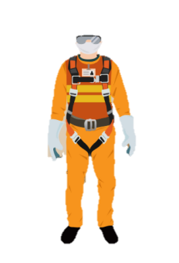
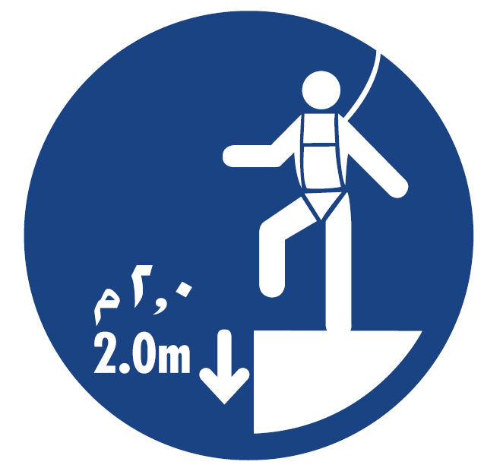
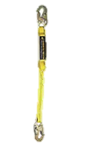
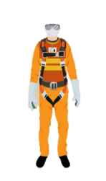
PDO Second Alert
Date: 01.11.2019 Incident title: LTI
What happened?
On 1st November, 2019 @around 22:00 hours, after lowering the mast crew was securing the stand pipe vibrator hose. Floor-men secured the first hose but while securing the second hose hammer union caught on substructure beam. Floor-man freed the hammer union by standing on the substructure beam and unlatched the lanyard to come out on rig floor. While coming out floor-man slipped and fell down to ground (Height: 3.4 meter).
Floor-man evacuated to rig clinic where medic administrated first aid and transferred him by rig ambulance to Nizwa hospital for further treatment.
Your learning from this incident..
Ensure adequate lighting available in the workplace if required.
Always use empowerment to stop if work is not safe.
Ensure all required personnel to have working at height training
Always plan for non essential activities to be carried out during day light.
Lanyard anchored with pad-eye
Follow LSR
Ensure that lanyard is always tied off while working at height
Notes:
Ensure all dates and titles are input
A short description should be provided without mentioning names of contractors or individuals. You should include, what happened, to who (by job title) and what injuries this resulted in. Nothing more!
Four to five bullet points highlighting the main findings from the investigation. Remember the target audience is the front line staff so this should be written in simple terms in a way that everyone can understand.
The strap line should be the main point you want to get across
The images should be self explanatory, what went wrong (if you create a reconstruction please ensure you do not put people at risk) and below how it should be done.

Slide 2
Management self audit
Date: 01.11.2019 Incident title : LTI
As a learning from this incident and ensure continual improvement all contract
managers must review their HSE HEMP against the questions asked below
Confirm the following:
Do you ensure there is sufficient light for night rig move activities?
Do you ensure that while working at height crew members always tie off their lanyard?
Do you plan night rig move activities with your supervisors?
Do you carry out random self-verification of on going activities?
Do you carry out self-verification of Management of change system?
* If the answer is NO to any of the above questions please ensure you take action to correct this finding.
Notes:
Ensure all dates and titles are input
Make a list of closed questions (only ‘yes’ or ‘no’ as an answer) to ask others if they have the same issues based on the management or HSE-MS failings or shortfalls identified in the investigation.
Imagine you have to audit other companies to see if they could have the same issues.
These questions should start with: Do you ensure…………………?

