Slide 1
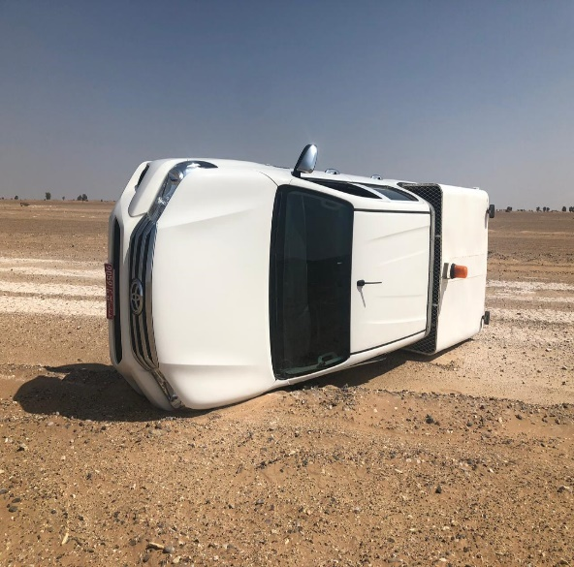
PDO Second Alert
Date:26th September 2019 Incident title HIPO#57 (MVI)
What happened?
On the 26th September a subcontractor driver was travelling alone by a company pick up - from Ibri to Lekhwair, while he continued to drive at around 14:02pm the driver did not concentrate on the road which made the vehicle to move to the side of the road. As the driver noticed the vehicle veering to the side of the road the driver panicked and over steered to the right causing the driver to lose control of the vehicle that caused the vehicle to roll on its left side. No injuries to the driver and minor damage to the vehicle
Your learning from this incident..
Always comply with journey plan and driving rules.
Always use approved route only.
Always conduct Pre-use inspection Prior to use any vehicle.
Always use your personal IVMS key only.
Always call emergency in case of incident without fail.
Always follow the speed limit at all times
Keep eyes on the road at all times
Notes:
Ensure all dates and titles are input
A short description should be provided without mentioning names of contractors or individuals. You should include, what happened, to who (by job title) and what injuries this resulted in. Nothing more!
Four to five bullet points highlighting the main findings from the investigation. Remember the target audience is the front line staff so this should be written in simple terms in a way that everyone can understand.
The strap line should be the main point you want to get across
The images should be self explanatory, what went wrong (if you create a reconstruction please ensure you do not put people at risk) and below how it should be done.

Slide 2
Management self audit
Date: 26th September 2019 Incident title HIPO 57 (MVI)
As a learning from this incident and ensure continual improvement all contract
managers must review their HSE HEMP against the questions asked below
Confirm the following:
Do you ensure that the drivers are daily checking the vehicles before using them ?
Do ensure that the drivers are aware of the risks of taking shortcuts?
Do you make sure that the drivers are following the journey plan?
Do you ensure that SP2000 is implemented ?
Do you ensure you review the subcontractors IVMS reports ?
* If the answer is NO to any of the above questions please ensure you take action to correct this finding.
Notes:
Ensure all dates and titles are input
Make a list of closed questions (only ‘yes’ or ‘no’ as an answer) to ask others if they have the same issues based on the management or HSE-MS failings or shortfalls identified in the investigation.
Imagine you have to audit other companies to see if they could have the same issues.
These questions should start with: Do you ensure…………………?

