Slide 1
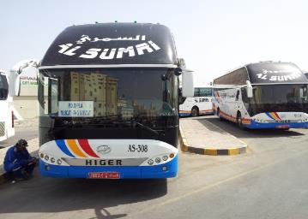
PDO Second Alert
Date: 1st July 2019 Incident title: Commuting fatality
What happened?
On 01st July’ 2019 a subcontractor employee was commuting in his private saloon car from his home at Suwaiq to Saih Rawl to commence his duty. At around 17.25 hrs, the vehicle hit rear end of Third Party flat bed trailer approx. 14km away from Qarn Alam roundabout. He passed away at the scene.
Your learning from this incident..
Follow company commuting policy and use PDO commuting services.
Follow road safety rules while driving your private vehicle.
Pay close attention to other road users in order to give yourself enough time to take any necessary actions.
Always ensure your vehicle is in good condition before starting any journey.
Always use approved commuting services
Notes:
Ensure all dates and titles are input
A short description should be provided without mentioning names of contractors or individuals. You should include, what happened, to who (by job title) and what injuries this resulted in. Nothing more!
Four to five bullet points highlighting the main findings from the investigation. Remember the target audience is the front line staff so this should be written in simple terms in a way that everyone can understand.
The strap line should be the main point you want to get across
The images should be self explanatory, what went wrong (if you create a reconstruction please ensure you do not put people at risk) and below how it should be done.

Slide 2
Management self audit
Date: 1st July 2019 Incident title: Commuting fatality
As a learning from this incident and ensure continual improvement all contract
managers must review their HSE HEMP against the questions asked below
Confirm the following:
Do you ensure commuting bus arrangements to discourage the use of private vehicles?
Do you ensure to promote safe driving practices with your drivers?
Do you ensure a Safe Commuting Policy?
Do you ensure your Policy discourage use of private vehicle?
* If the answer is NO to any of the above questions please ensure you take action to correct this finding.
Notes:
Ensure all dates and titles are input
Make a list of closed questions (only ‘yes’ or ‘no’ as an answer) to ask others if they have the same issues based on the management or HSE-MS failings or shortfalls identified in the investigation.
Imagine you have to audit other companies to see if they could have the same issues.
These questions should start with: Do you ensure…………………?

