Slide 1
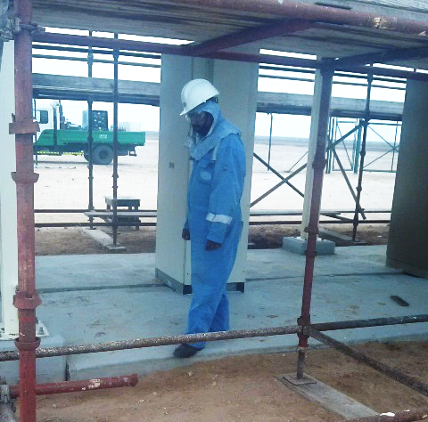
PDO Incident First Alert
Incident Type | LTI#06 | Pattern | Slip & Fall
Date / Time | 13.04.2020@12:15hrs | Directorate
Location | Qarn Alam | Dept
Target Audience
Construction, Operations, Logistics, Engineering , Exploration & Drilling
What happened
While stepping down from a concreate floor, the Rigger slipped twisting his left ankle resulting in a fracture.
Mr. Musleh asks the questions of can it happen to you?
How do you ensure where you are stepping is free from Hazards?
How do you ensure you have safe access and egress at your work and camp site?
How do you identify Slip, Trips and fall points at work and camp site?
Please disseminate this LTI notification to your teams and use it in your tool box talks and HSE meetings and notice boards.

