Slide 1
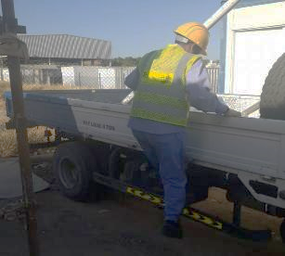
PDO Incident First Alert
Incident Type | LTI#09 | Pattern | Slip , Trip & Fall
Date / Time | 09.05.2020 at 08: 30:00hrs | Directorate
Location | Min Al Fahal | Dept
Target Audience
Construction, Operations, Logistics, Engineering , Exploration & Drilling
What happened
While the Mason was climbing over the side of a 3t truck, he lost his balance falling backwards fracturing his wrist.
Mr. Musleh asks the questions of can it happen to you?
How do you ensure you identify all hazards before starting a task?
Do you consider “what could go wrong?”
Do you consider if you can fall from height?
Do you consider safe access and egress?
AD fell into the cross beam
Please disseminate this LTI notification to your teams and use it in your tool box talks and HSE meetings and notice boards.

