Slide 1
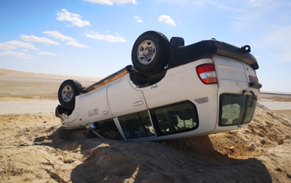
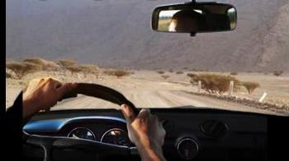
PDO Second Alert
Date: 16th November 2019 Incident title: MVI Rollover
What happened?
While two mechanical technicians driving a land Cruiser vehicle in a graded road from Nimr to Howqa in order to repair a broken-down slickline unit, after Zauliyah-Howqa intersection (5.3km). The driver who was talking to the passenger while driving involved in a deep conversation with the passenger. The vehicle veered off to the left side of the road to hit a sand ramp. There were no injuries.
Your learning from this incident..
Always stay focused on the driving task while you are behind the wheel..
Always assess the roadways hazards and stop if unsafe.
Always follow the Safe Journey Plan instructions when taking your journey.
Do not take risky maneuvers while driving.
Don’t get Distracted ! Stay focused while driving
Notes:
Ensure all dates and titles are input
A short description should be provided without mentioning names of contractors or individuals. You should include, what happened, to who (by job title) and what injuries this resulted in. Nothing more!
Four to five bullet points highlighting the main findings from the investigation. Remember the target audience is the front line staff so this should be written in simple terms in a way that everyone can understand.
The strap line should be the main point you want to get across
The images should be self explanatory, what went wrong (if you create a reconstruction please ensure you do not put people at risk) and below how it should be done.

Slide 2
Management self audit
Date: 16th November 2019 Incident title: MVI Rollover
As a learning from this incident and ensure continual improvement all contract
managers must review their HSE HEMP against the questions asked below
Confirm the following:
Do you ensure that all of vehicles tyres are inspected closely for signs of rubber fatigue as part of the regular safety and RAS inspections ?
Do you ensure that distracted driving and tyre puncture are part of your HEMP?
Do you ensure that your drivers are well trained on defensive driving techniques?
Do you ensure that learning from incidents are well disseminated to your staff?
Do you ensure that journeys above 200km are well-managed?
* If the answer is NO to any of the above questions please ensure you take action to correct this finding.
Notes:
Ensure all dates and titles are input
Make a list of closed questions (only ‘yes’ or ‘no’ as an answer) to ask others if they have the same issues based on the management or HSE-MS failings or shortfalls identified in the investigation.
Imagine you have to audit other companies to see if they could have the same issues.
These questions should start with: Do you ensure…………………?

