Slide 1
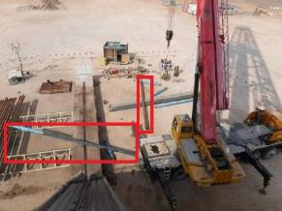
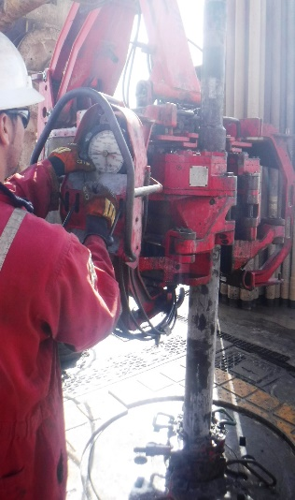
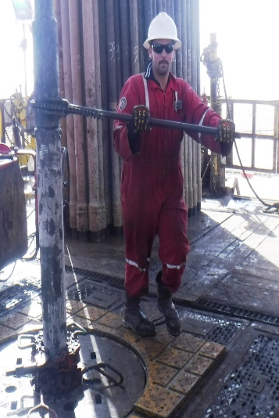
PDO Second Alert
Date: 20th November 2019 Incident title: Drops HiPo#74
What happened?
While making up 12 1/4" bit, to near bit stabilizer with a double of 8-1/4” drill collars, lifting sub at elevators unscrewed from connection to 8 1/4'' drill collar and BHA(Bottom hole assembly) fell down to ground in Cat walk Area. No Injuries reported as red zone management was in place, but equipment damage reported.
Your learning from this incident..
Always establish a good communication among the workers.
Always ensure procedures are clear, understood and followed.
Always ensure complete task discussed and understood by the workers
Driller to ensure and confirm correct torque.
Always stay away from line of fire and make sure no one is in red zone
TP or NTP MUST be available at rig floor while making up BHA
Follow correct procedure and use appropriate tools
Notes:
Ensure all dates and titles are input
A short description should be provided without mentioning names of contractors or individuals. You should include, what happened, to who (by job title) and what injuries this resulted in. Nothing more!
Four to five bullet points highlighting the main findings from the investigation. Remember the target audience is the front line staff so this should be written in simple terms in a way that everyone can understand.
The strap line should be the main point you want to get across
The images should be self explanatory, what went wrong (if you create a reconstruction please ensure you do not put people at risk) and below how it should be done.

Slide 2
Management self audit
Date: 20th November 2019 Incident title: Drops HiPo#74
As a learning from this incident and ensure continual improvement all contract
managers must review their HSE HEMP against the questions asked below
Confirm the following:
Do you ensure there is adequate supervision for the critical tasks?
Do you carry out random self-verification of on going activities?
Do you ensure the crew are utilizing procedures/JSA?
Do you ensure crew knows the correct torque for the connection?
Do you utilize review of CCTV footages during critical activities?
* If the answer is NO to any of the above questions please ensure you take action to correct this finding.
Notes:
Ensure all dates and titles are input
Make a list of closed questions (only ‘yes’ or ‘no’ as an answer) to ask others if they have the same issues based on the management or HSE-MS failings or shortfalls identified in the investigation.
Imagine you have to audit other companies to see if they could have the same issues.
These questions should start with: Do you ensure…………………?

