Slide 1
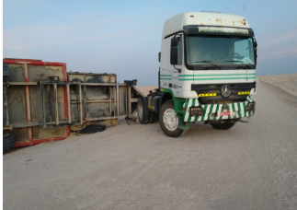
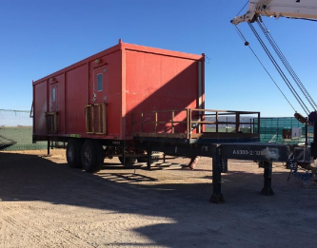
PDO Second Alert
Date: 29th November 2019 Incident title: HiPo#78
What happened?
While sub contractor logistics company was hauling the TP office to Saih-rawl, 24 km away from MBR-36, the TP office tipped over aside the road. The truck driver oversteered suddenly causing the incident.
Your learning from this incident..
All risks must be assessed and mitigated to ALARP.
All vehicle inspection checklist must be completed before any rig move.
Journey plan must be adhered to.
Adapt driving speed to road conditions and not only speed limit of the road.
Remain vigilant for any change in road conditions at all times.
Always apply your defensive driving skills
Ensure all RISKs are assessed!
Notes:
Ensure all dates and titles are input
A short description should be provided without mentioning names of contractors or individuals. You should include, what happened, to who (by job title) and what injuries this resulted in. Nothing more!
Four to five bullet points highlighting the main findings from the investigation. Remember the target audience is the front line staff so this should be written in simple terms in a way that everyone can understand.
The strap line should be the main point you want to get across
The images should be self explanatory, what went wrong (if you create a reconstruction please ensure you do not put people at risk) and below how it should be done.

Slide 2
Management Self Audit
Date: 29th November 2019 Incident title: HiPo#78
As a learning from this incident and ensure continual improvement all contract
managers must review their HSE HEMP against the questions asked below
Confirm the following:
Do you ensure that previous incident learnings are refreshed within your organization and subcontractors?
Do you ensure that Journey planning is done for all trips as per SP2000?
Do you ensure that pre trip trailers check list are completed?
* If the answer is NO to any of the above questions please ensure you take action to correct this finding.
Notes:
Ensure all dates and titles are input
Make a list of closed questions (only ‘yes’ or ‘no’ as an answer) to ask others if they have the same issues based on the management or HSE-MS failings or shortfalls identified in the investigation.
Imagine you have to audit other companies to see if they could have the same issues.
These questions should start with: Do you ensure…………………?

