Slide 1
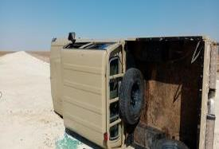
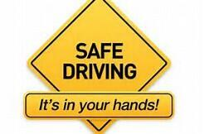
PDO Second Alert
Date: 21st December 2019 Incident title: HiPo#85 MVI
What happened?
Driver and Surveyor (passenger) were travelling in a Land Cruiser pick up on the Jaleel main graded road towards Jaleel South west – C site, performing road survey activity. The driver lost control while negotiating a right-hand turn at the T and this resulted in the vehicle rolling over and resting on the drivers side. The Driver and Passenger received no injuries and managed to safely exit the vehicle.
Your learning from this incident..
Always slow done when approaching a sharp bend or junction on a graded road
Always intervene with a driver if you feel that he does not drive safely
Always conduct proper TBT with drivers explaining the effects of bad weather and road conditions
Always ensure to report damaged / bad road conditions for repairs
Always drive to the road conditions
Notes:
Ensure all dates and titles are input
A short description should be provided without mentioning names of contractors or individuals. You should include, what happened, to who (by job title) and what injuries this resulted in. Nothing more!
Four to five bullet points highlighting the main findings from the investigation. Remember the target audience is the front line staff so this should be written in simple terms in a way that everyone can understand.
The strap line should be the main point you want to get across
The images should be self explanatory, what went wrong (if you create a reconstruction please ensure you do not put people at risk) and below how it should be done.

Slide 2
Management self audit
Date: 21st December 2019 Incident title: HiPo#85 MVI
As a learning from this incident and ensure continual improvement all contract
managers must review their HSE HEMP against the questions asked below
Confirm the following:
Do you ensure that an effective system is in place and working to review driver performance meeting all SP 2000 requirements?
Do you ensure that Tetra radio / Thuraya phone is available to effectively communicate & manage journeys to remote locations or areas with no mobile coverage?
Do you ensure the controls of driving in bad weather & road conditions are discussed with drivers in TBT?
Do you ensure that bad road conditions are reported to appropriate PDO focal point and followed through for action closure?
Do you ensure HEMP and all related documents related journey management are up to date and communicated?
* If the answer is NO to any of the above questions please ensure you take action to correct this finding.
Notes:
Ensure all dates and titles are input
Make a list of closed questions (only ‘yes’ or ‘no’ as an answer) to ask others if they have the same issues based on the management or HSE-MS failings or shortfalls identified in the investigation.
Imagine you have to audit other companies to see if they could have the same issues.
These questions should start with: Do you ensure…………………?

