Slide 1
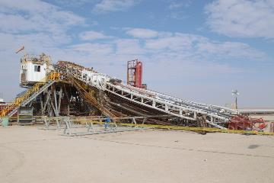
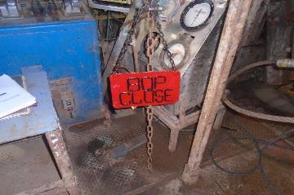
PDO Second Alert
Date: 5th December 2019 Incident title: Fatality
What happened?
At approximately 16:20hrs on 5th December 2019, when Driller commenced pulling out of hole, the entire mast with setback stands collapsed towards the catwalk / pipe rack area. The derrick man died at the well site. One floor man sustained broken rib, Geologist with a cut injury on his forehead and another floor man with pain on his left leg.
Your learning from this incident..
Ensure “BOP CLOSED” board is displayed on the brake when BOP is in closed position.
Always maintain good communication between Driller and Assistant driller.
Ensure guy lines are intact and under correct tension.
Ensure crew is fully aware of the operating parameters of the Rig including maximum pulling capacity.
Ensure the hoisting system is not putting the mast as the weakest point.
Respect zone management.
Always ensure the BOP is open prior to pulling out of hole
Notes:
Ensure all dates and titles are input
A short description should be provided without mentioning names of contractors or individuals. You should include, what happened, to who (by job title) and what injuries this resulted in. Nothing more!
Four to five bullet points highlighting the main findings from the investigation. Remember the target audience is the front line staff so this should be written in simple terms in a way that everyone can understand.
The strap line should be the main point you want to get across
The images should be self explanatory, what went wrong (if you create a reconstruction please ensure you do not put people at risk) and below how it should be done.

Slide 2
Management self audit
Date: 5th December 2019 Incident title: Fatality
As a learning from this incident and ensure continual improvement all contract
managers must review their HSE HEMP against the questions asked below
Confirm the following:
Do you ensure all modifications on the Rig are done with OEM approval?
Do you ensure all upgrades are done under MOC?
Do you ensure proper hand over between Driller and Assistant driller?
Do you ensure Guy lines are under correct tension at all times?
Do you ensure the mast is not the weakest link in the hoisting system?
Do you ensure the draw-work interlock is installed to prevent accidental operation whilst the BOP is closed?
Do you ensure that adherence to the PSP is verified?
Do you ensure that the effectiveness of the assurance program?
* If the answer is NO to any of the above questions please ensure you take action to correct this finding.
Notes:
Ensure all dates and titles are input
Make a list of closed questions (only ‘yes’ or ‘no’ as an answer) to ask others if they have the same issues based on the management or HSE-MS failings or shortfalls identified in the investigation.
Imagine you have to audit other companies to see if they could have the same issues.
These questions should start with: Do you ensure…………………?

