Slide 1
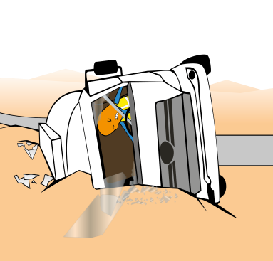
PDO Incident First Alert
Incident Type | LTI#19 | Pattern | MVI
Date / Time | 20.08.2020@14:05hrs | Directorate
Location | Adam | Dept
Target Audience
Logistics , Drilling, Operations, Engineering & Construction
What happened
While driving a load of chemical to Nimr, the driver lost control of the vehicle resulted in the vehicle rolled over and catching fire. The driver suffered multiple burn injuries.
Mr. Musleh asks the questions of can it happen to you?
Do you always apply defensive driving techniques?
Do you ensure you check your vehicle prior to starting your journey?
Do you ensure you drive according to the road conditions?
Do you drive if you are fatigue?
Please disseminate this LTI notification to your teams and use it in your tool box talks and HSE meetings and notice boards.

