Slide 1
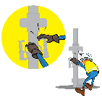
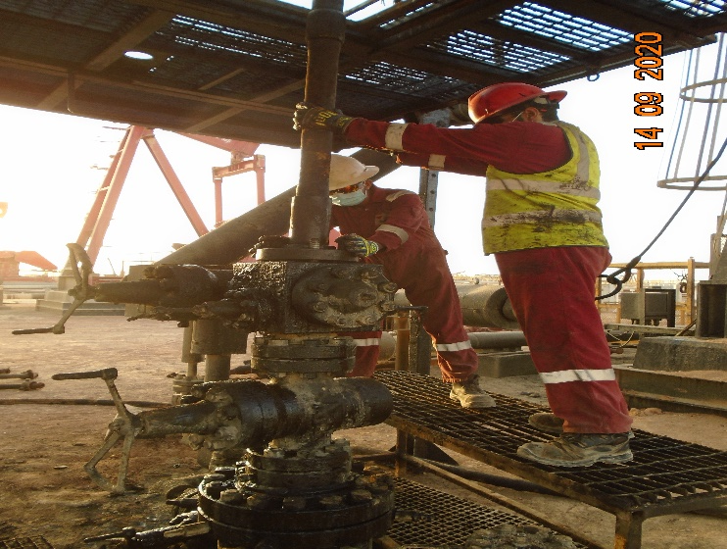
PDO Incident First Alert
Incident Type | LTI#22 | Pattern | Hands and Fingers
Date / Time | 14.09.2020@04:30hrs | Directorate
Location | Marmul | Dept
Target Audience
Drilling, Operations, Engineering & Construction
What happened
While the Floor man was installing Sucker Rod Bop flange into the Xmas tree, his right ring finger got crushed between the flange and Xmas tree.
Mr. Musleh asks the questions of can it happen to you?
How do you ensure your Hands & Fingers are away from ‘Line of Fire’?
How do you ensure you identify all hazards before starting a task?
Do you consider “what could go wrong?”
Do you observes your colleague’s action during task and intervene if required?
Do you ensure adequate Supervision during task?
Please disseminate this LTI notification to your teams and use it in your tool box talks and HSE meetings and notice boards.

