Slide 1
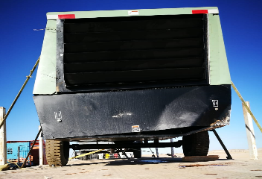
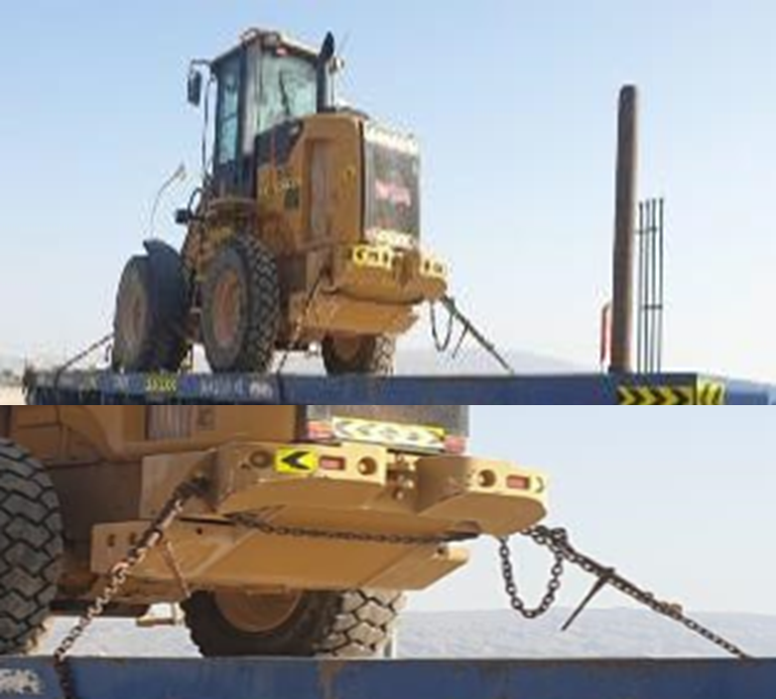
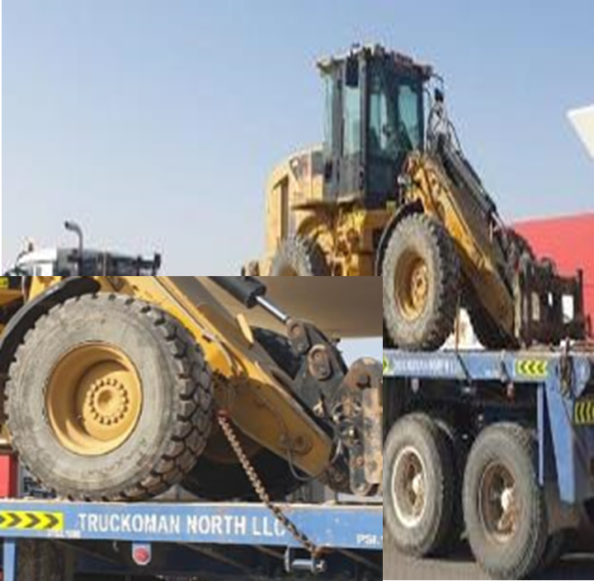
PDO Second Alert
Date: 20.01.2020 Incident title: HiPo#03
What happened?
On 20th Jan 2020 at 16:03 pm during Rig down operation, well testing crew completed loading of two air compressors on a flat bed trailer. After loading is completed, Heavy truck driver from sub contractor company secured compressors with cargo belts and then moved the truck towards wellsite. While approaching the well pad (300 meters from the loading point) compressor that was placed on the back of the trailer rolled off from the trailer (approx. 1.6 m) and landed on the ground. Driver immediately stopped the trailer. Minor damaged sustained to the compressor housing. No injuries were reported.
Your learning from this incident..
Always ensure all loads are secured as per SP2001.
Always ensure wheeled loads are lashed and applied brake system while transported on graded roads.
Do not allow trailer to move unless all items are properly secured.
Ensure trucks are equipped with required accessories for safe securing.
Be Aware and Implement the Lashing Requirements for Wheeled Load as per SP 2001
Target Audience: Drilling, Logistics, Engineering & Construction
Notes:
Ensure all dates and titles are input
A short description should be provided without mentioning names of contractors or individuals. You should include, what happened, to who (by job title) and what injuries this resulted in. Nothing more!
Four to five bullet points highlighting the main findings from the investigation. Remember the target audience is the front line staff so this should be written in simple terms in a way that everyone can understand.
The strap line should be the main point you want to get across
The images should be self explanatory, what went wrong (if you create a reconstruction please ensure you do not put people at risk) and below how it should be done.

Slide 2
Management self audit
Date: 20.01.2020 Incident title: HiPo#03
As a learning from this incident and ensure continual improvement all contract
managers must review their HSE HEMP against the questions asked below
Confirm the following:
Do you ensure that your audits on sub contractor covers implementation and work practices?
Do you ensure you Audit their implementation and work practices against SP 2001?
Do you ensure that SP 2001 requirements are captured in your Loading and transportation SOP’s?
Do you ensure your operational team are provide with periodic awareness sessions against SP 2001 and relevant work standards?
Do you ensure that your daily vehicle inspections capture all the necessary SP 2001 requirements and relevant securing accessories?
Do you ensure Sub Contractors are properly managed and they comply with all required standards and regulation?
* If the answer is NO to any of the above questions please ensure you take action to correct this finding.
Notes:
Ensure all dates and titles are input
Make a list of closed questions (only ‘yes’ or ‘no’ as an answer) to ask others if they have the same issues based on the management or HSE-MS failings or shortfalls identified in the investigation.
Imagine you have to audit other companies to see if they could have the same issues.
These questions should start with: Do you ensure…………………?

