Slide 1
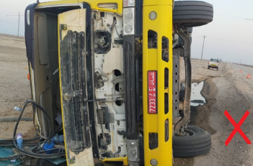
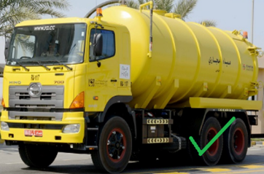
PDO Second Alert
Date:19.02.2020 Incident title: HiPo#08
What happened?
After loading sewage tanker from rig 123 Camp at 12: 45 HRS , was heading towards Fahud. At 15:22 HRS in Wadi Mussalam graded road and the driver pull the vehicle to the side of the road which was covered with soft sand which made the vehicle to drift off-road. When the driver realized, he tried to steer back the vehicle to the road which led the tanker to tip over. Due to his seatbelt, the driver was unharmed and managed to get out safely.
Your learning from this incident..
Ensure when the vehicle is half loaded driver must ensure use of DD techniques.
Always ensure to highlight the main hazards of graded road, which comprises dust cloud and the loose sand at the edge off the road during TBT.
Ensure do not drift offline to avoid dust cloud.
Ensure hold the steering wheel tight and straight with both hands, keep the same line the vehicle is travelling. Break firmly but constantly to a full stop.
SJM have to ensure that all Identified hazard in HEMP must be communicated in all TBT’s, and assure and acknowledge the under standing from the drivers.
Always Follow the DD techniques while Driving
Target Audience: Drilling, Logistics, Engineering & construction
Notes:
Ensure all dates and titles are input
A short description should be provided without mentioning names of contractors or individuals. You should include, what happened, to who (by job title) and what injuries this resulted in. Nothing more!
Four to five bullet points highlighting the main findings from the investigation. Remember the target audience is the front line staff so this should be written in simple terms in a way that everyone can understand.
The strap line should be the main point you want to get across
The images should be self explanatory, what went wrong (if you create a reconstruction please ensure you do not put people at risk) and below how it should be done.

Slide 2
Management self audit
Date:19.02.2020 Incident title: HiPo#08
As a learning from this incident and ensure continual improvement all contract
managers must review their HSE HEMP against the questions asked below
Confirm the following:
Do you ensure that your subcontractor has audit plan in place that includes HSE MS?
Do your ensure that your drivers get a full brief on the road and weather related risks and hazard before they set off on their trip?
Do your drivers know how to react when their vehicle is drifting in loose sand?
Do you ensure your tanker drivers are aware about the risk related to liquid shifting inside the tank during transport?
Do you ensure that you have completed verification audit for sub contractors?
* If the answer is NO to any of the above questions please ensure you take action to correct this finding.
Notes:
Ensure all dates and titles are input
Make a list of closed questions (only ‘yes’ or ‘no’ as an answer) to ask others if they have the same issues based on the management or HSE-MS failings or shortfalls identified in the investigation.
Imagine you have to audit other companies to see if they could have the same issues.
These questions should start with: Do you ensure…………………?

