Slide 1
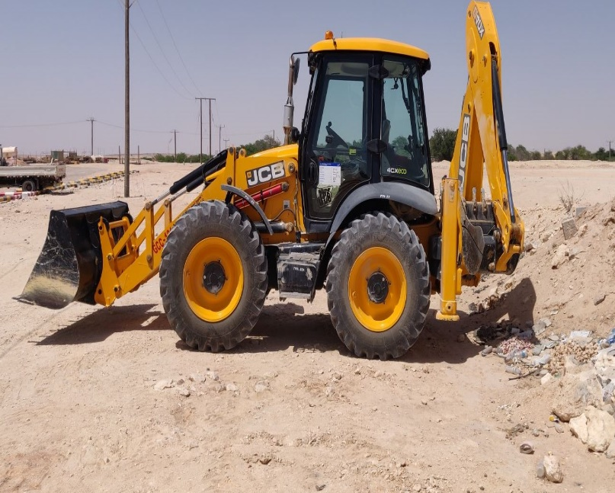
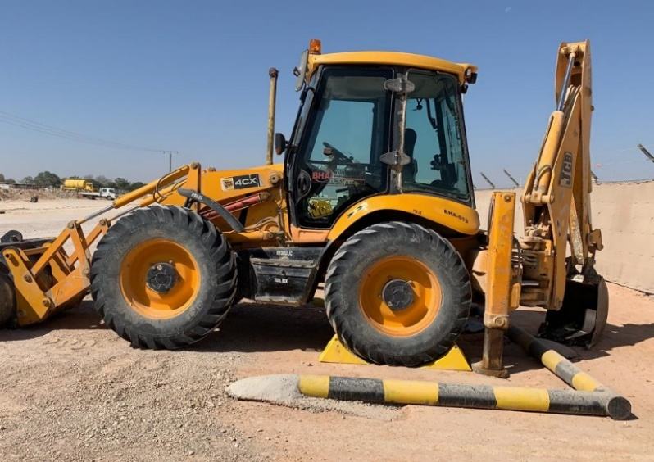
PDO Second Alert
Date: 29.03.2020 Incident title: HiPo#23
What happened?
JCB operator after parking the equipment forgot to engage handbrake, he alighted from the cabin and started walking towards office. After a while JCB rolled 01 meter backwards and rested on a soil bund.
Your learning from this incident..
Always make sure to park the equipment in a proper way and engage
handbrake before leaving the cabin.
Always park at the designated parking areas.
Use wheel chokes wherever necessary.
Always ensure that heavy plants are not used for regular commuting to and from site.
Park in a designated area, engage handbrakes and place wheel chocks
Target Audience: Drilling, Logistics, Operation & Construction
Notes:
Ensure all dates and titles are input
A short description should be provided without mentioning names of contractors or individuals. You should include, what happened, to who (by job title) and what injuries this resulted in. Nothing more!
Four to five bullet points highlighting the main findings from the investigation. Remember the target audience is the front line staff so this should be written in simple terms in a way that everyone can understand.
The strap line should be the main point you want to get across
The images should be self explanatory, what went wrong (if you create a reconstruction please ensure you do not put people at risk) and below how it should be done.

Slide 2
Management self audit
Date: 29.03.2020 Incident title: HiPo#23
As a learning from this incident and ensure continual improvement all contract
managers must review their HSE HEMP against the questions asked below
Confirm the following:
Do you ensure that lateral learnings from incidents are effectively implemented?
Do you ensure that adequate parking slots are provided?
Do you ensure that vehicles and plants are parked in a designated parking areas?
Do you ensure that your employees are aware of previous incident learnings?
Do you ensure that all heavy equipments are provided with wheel chocks?
* If the answer is NO to any of the above questions please ensure you take action to correct this finding.
Notes:
Ensure all dates and titles are input
Make a list of closed questions (only ‘yes’ or ‘no’ as an answer) to ask others if they have the same issues based on the management or HSE-MS failings or shortfalls identified in the investigation.
Imagine you have to audit other companies to see if they could have the same issues.
These questions should start with: Do you ensure…………………?

