Slide 1
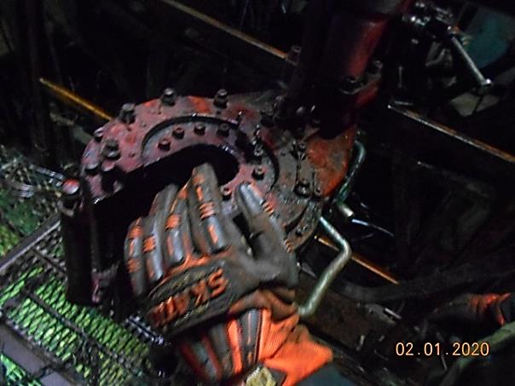
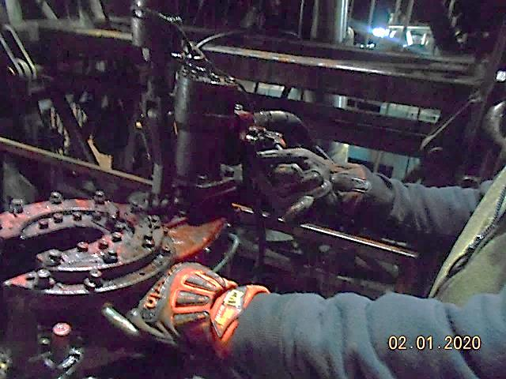
PDO Second Alert
Date: 01.01.2020 Incident title: LTI#01, Finger Injury
What happened?
During RIH of 1” Sucker Rod (SR) operation, the floor man adjusted the SR power tong position by pushing it towards the mast. While doing so, the operating lever hit against the mast causing the tong to start functioning. The right hand middle Finger had been placed on the tong got caught in the rotating tong resulting in injuring the finger tip from below the nail.
Your learning from this incident..
Always ensure to be aware of all pinch points in the work surroundings.
Always ensure you are not in the line of fire of the rotating machinery.
Always ensure energized equipment are isolated when not in use.
Always ensure proper supervision to Stop and Intervene when unsafe acts are observed.
Always Ensure to conduct effective & dynamic TBTs to identify the hazards from pinch points and Line of fire.
Do not place hands in the pinch point areas
Target Audience: Drilling, Operations, Logistics, Engineering & Construction
Notes:
Ensure all dates and titles are input
A short description should be provided without mentioning names of contractors or individuals. You should include, what happened, to who (by job title) and what injuries this resulted in. Nothing more!
Four to five bullet points highlighting the main findings from the investigation. Remember the target audience is the front line staff so this should be written in simple terms in a way that everyone can understand.
The strap line should be the main point you want to get across
The images should be self explanatory, what went wrong (if you create a reconstruction please ensure you do not put people at risk) and below how it should be done.

Slide 2
Management self audit
Date: 01.01.2020 Incident title: LTI#01, Finger Injury
As a learning from this incident and ensure continual improvement all contract
managers must review their HSE HEMP against the questions asked below
Confirm the following:
Do you ensure inspection/checks on hydraulic equipment before starting ?
Do you ensure that all employee are aware of the Hands off Rules and identified pinch points?
Do you ensure that all hazards has been identified by Dynamic TBTs?
Do you ensure that effective assurance process in place to monitor STOP and intervention?
Do you ensure that Workplace have signage on Pinch points and Hands Off?
Do you ensure all the rotational machinery has protective guards fixed onto them?
Do you ensure that your SOP are adequately developed and reviewed regularly to fit for the operation?
Do you ensure that CCTV review has been done regularly to identify critical unsafe behaviors?
* If the answer is NO to any of the above questions please ensure you take action to correct this finding.
Notes:
Ensure all dates and titles are input
Make a list of closed questions (only ‘yes’ or ‘no’ as an answer) to ask others if they have the same issues based on the management or HSE-MS failings or shortfalls identified in the investigation.
Imagine you have to audit other companies to see if they could have the same issues.
These questions should start with: Do you ensure…………………?

