Slide 1
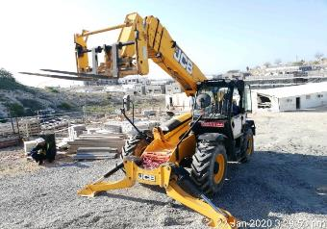
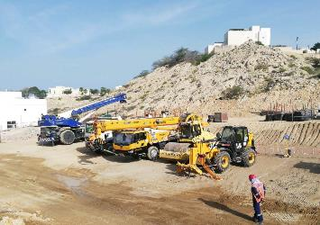
PDO Second Alert
Date: 18.01.2020 Incident title: LTI#02, Fatality
What happened?
An unmanned Telehandler parked on raised ground adjacent to rest area, began to roll back down a slope, resulting in striking the wall of the rest area, leading to the collapse of the wall onto the head of a mason who was resting inside, the mason succumbed to his injury after a week in intensive care.
Your learning from this incident.
Always ensure dedicated parking area for heavy equipment is available.
Operators & banksmen to ensure Equipment is parked safely at all times.
Operators and Banksmen to ensure secondary protection such as Wheel Chocks are placed, prior to leaving the equipment.
Unnecessary construction materials not to be stored in welfare facilities.
Ensure competent and experienced Operators are deployed at task.
Check your Plant & Machinery Parked Properly before you Leave.
Target Audience: Drilling, Operations, Logistics, Engineering & Construction
Notes:
Ensure all dates and titles are input
A short description should be provided without mentioning names of contractors or individuals. You should include, what happened, to who (by job title) and what injuries this resulted in. Nothing more!
Four to five bullet points highlighting the main findings from the investigation. Remember the target audience is the front line staff so this should be written in simple terms in a way that everyone can understand.
The strap line should be the main point you want to get across
The images should be self explanatory, what went wrong (if you create a reconstruction please ensure you do not put people at risk) and below how it should be done.

Slide 2
Management self audit
Date: 18.01.2020 Incident title: LTI#02, Fatality
As a learning from this incident and ensure continual improvement all contract
managers must review their HSE HEMP against the questions asked below
Confirm the following:
Do you ensure designated parking areas for all construction Equipment are allotted & Risk assessment carried out?
Do you ensure the Operators follows the OEM procedures?
Do you ensure Competency of the Operators?
Do you ensure the roles and responsibilities of the Banksman are communicated?
Do you ensure operator competency within your recruitment procedure?
Do you ensure hazard hunts are carried out in all on-site facilities?
Do you ensure your site establishment plan is in alignment to current stage of Project?
Do you ensure that Emergency response plan is tested and includes occurrence of emergency situations adjacent to Assembly point ?
* If the answer is NO to any of the above questions please ensure you take action to correct this finding.
Notes:
Ensure all dates and titles are input
Make a list of closed questions (only ‘yes’ or ‘no’ as an answer) to ask others if they have the same issues based on the management or HSE-MS failings or shortfalls identified in the investigation.
Imagine you have to audit other companies to see if they could have the same issues.
These questions should start with: Do you ensure…………………?

