Slide 1
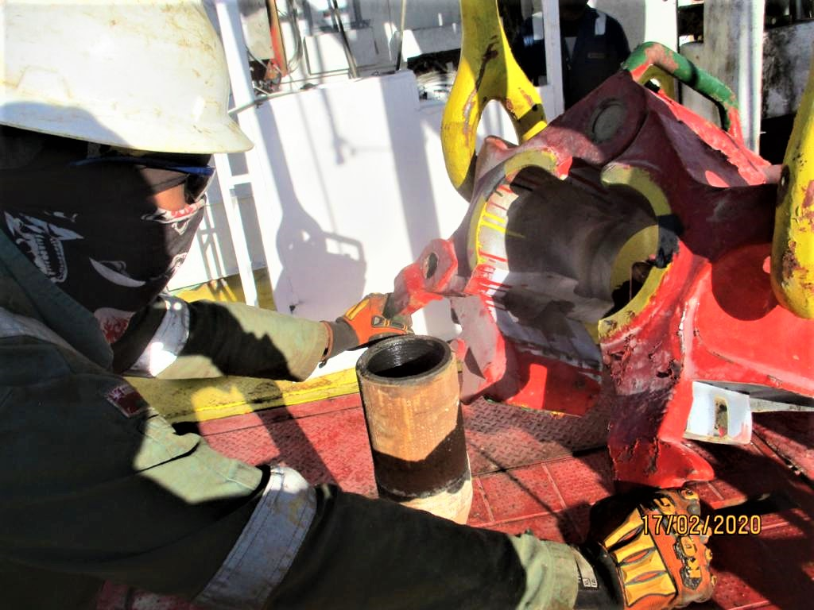
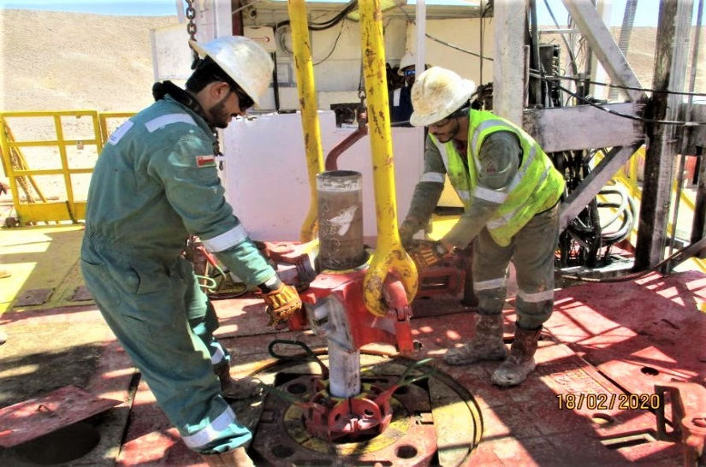
PDO Second Alert
Date: 29.01.2020 Incident title: LTI#03, Finger Injury
What happened?
While POOH and laying down of 5”drill pipes, Floor man was latching the drill pipe elevator to the drill string on rotary . While doing so ,his finger got trapped between the elevator and the drill pipe joint causing left hand thump to get injured. He was immediately taken to the clinic and then taken to nearby hospital for further examination.
Your learning from this incident..
Ensure people are not in contact with any mechanical hazards on Rig-floor such as moving items, suspended loads or unstable handling tools.
Ensure work is well controlled on rig floor and people are not distracted by any side communications or multi tasks.
Ensure proper process in place to utilize CCTV for monitoring, intervening and learnings.
Comply with Red Zone & No Go Zone Management
Target Audience: Drilling, Operations, Logistics, Engineering & Construction
Notes:
Ensure all dates and titles are input
A short description should be provided without mentioning names of contractors or individuals. You should include, what happened, to who (by job title) and what injuries this resulted in. Nothing more!
Four to five bullet points highlighting the main findings from the investigation. Remember the target audience is the front line staff so this should be written in simple terms in a way that everyone can understand.
The strap line should be the main point you want to get across
The images should be self explanatory, what went wrong (if you create a reconstruction please ensure you do not put people at risk) and below how it should be done.

Slide 2
Management self audit
Date: 29.01.2020 Incident title: LTI#03, Finger Injury
As a learning from this incident and ensure continual improvement all contract
managers must review their HSE HEMP against the questions asked below
Confirm the following:
Do you ensure that your handover protocol including HSE controls on rig floor?
Do you ensure key personnel are implementing their HSE responsibilities as required?
Do you ensure that CCTV is utilized for monitoring, Intervening and Learning?
Do you ensure compliance PDO SP2097 (Prevention of Dropped Objects)?
Do you ensure that your STOP system is effective and well implemented?
* If the answer is NO to any of the above questions please ensure you take action to correct this finding.
Notes:
Ensure all dates and titles are input
Make a list of closed questions (only ‘yes’ or ‘no’ as an answer) to ask others if they have the same issues based on the management or HSE-MS failings or shortfalls identified in the investigation.
Imagine you have to audit other companies to see if they could have the same issues.
These questions should start with: Do you ensure…………………?

