Slide 1
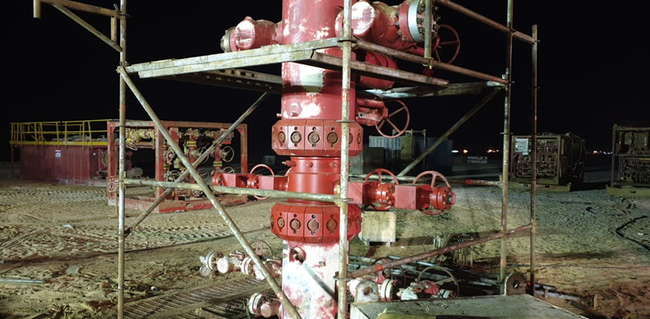
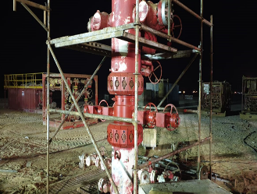
PDO Second Alert
Date: 04.02.2020 Incident title: LTI#04, R Foot Injury
What happened?
On 4-2-2020 at 22: 45 during rig down operations, Hydraulic Workover Operator was working alone to dismantle the scaffold. He decided to climb on top of the scaffold lower crossbeam to remove the platform, somehow he slipped and fall landing on his right foot and twisted his right ankle.
Your learning from this incident.
Always ensure job planning is done and effectively communicated.
Always ensure detailed step by step procedure for the task exist.
Always use trained and certified crew for handling scaffold.
Always ensure to have the adequate tool for the task.
Always mind your footing.
Always use Stop work authorities (Intervene) when you’re uncertain of the task to perform.
Ensure you always assess your steps!
Target Audience: Drilling, Operations, Logistics, Engineering & Construction
Notes:
Ensure all dates and titles are input
A short description should be provided without mentioning names of contractors or individuals. You should include, what happened, to who (by job title) and what injuries this resulted in. Nothing more!
Four to five bullet points highlighting the main findings from the investigation. Remember the target audience is the front line staff so this should be written in simple terms in a way that everyone can understand.
The strap line should be the main point you want to get across
The images should be self explanatory, what went wrong (if you create a reconstruction please ensure you do not put people at risk) and below how it should be done.

Slide 2
Management self audit
Date: 04.02.2020 Incident title: LTI#04, R Foot Injury
As a learning from this incident and ensure continual improvement all contract
managers must review their HSE HEMP against the questions asked below
Confirm the following:
Do you ensure scaffolding operations is covered in the existing HEMP?
Do you ensure all the employees aware of the scaffolding usage and best practices?
Do you ensure that detailed Job Safety Analysis / Toolbox talks are completed for the task?
Do you ensure out of sight locations are identified into Job Safety Analysis?
Do you ensure that the Permit to Work system is properly done on all job site and, is this audited?
* If the answer is NO to any of the above questions please ensure you take action to correct this finding.
Notes:
Ensure all dates and titles are input
Make a list of closed questions (only ‘yes’ or ‘no’ as an answer) to ask others if they have the same issues based on the management or HSE-MS failings or shortfalls identified in the investigation.
Imagine you have to audit other companies to see if they could have the same issues.
These questions should start with: Do you ensure…………………?

