Slide 1
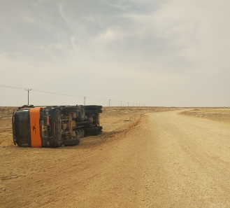
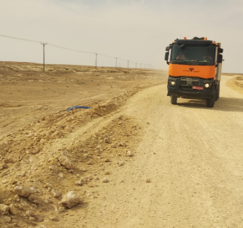
PDO Second Alert
Date: 22.04.2020 Incident title: Hipo#26
What happened?
A loaded tipper proceeding to Rakid Loc 5 from borrow pit in Misbah lost control while executing a left turn and tipped over to right. No injury to driver. Slight damage to front wind shield and diesel tank. PDO Emergency No and RSST informed.
Your learning from this incident..
Maintain a safe distance from road edges.
Always Keep your eyes on the road and practice defensive driving techniques.
Check and inspect your vehicle to ensure it is free of defects. Report any defects or problems you do find with your vehicle immediately.
Always call PDO emergency number immediately.
Be vigilant and attentive while driving on graded roads
Target Audience: Drilling, Logistics & Construction

Slide 2
Management self audit
Date: 22.04.2020 Incident title: Hipo#26
As a learning from this incident and ensure continual improvement all contract
managers must review their HSE HEMP against the questions asked below
Confirm the following:
Do you ensure that new drivers are adequately mentored prior to assigning the task?
Do have a formal system to monitor the driver’s behaviour other than IVMS?
Do you assure that your drivers have adequate experience driving the specific vehicle they are assigned to?
Do we ensure that your drivers report all defects they encounter during driving?
Do you ensure that all vehicles are fit to drive?
Do you ensure that learning from incidents are cascaded to all drivers?
* If the answer is NO to any of the above questions please ensure you take action to correct this finding.
Notes:
Make a list of closed questions (only ‘yes’ or ‘no’ as an answer) to ask other contractors if they have the same issues based on the management or HSE-MS failings or shortfalls identified in the investigation. Pretend you have to audit other companies to see if they could have the same issues.

