Slide 1
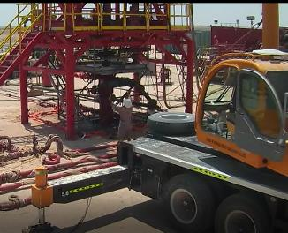
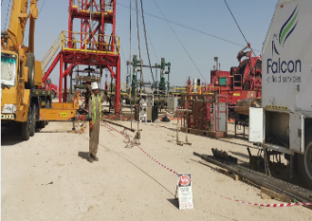
PDO Second Alert
Date: 21.04.2020 Incident title: HiPo#27
What happened?
While POOH and rig down of tool string in Frac-8, the ledge of tools got engaged and stuck in coiled tubing tower that lead to weak point snapping. As a result, the tool string released from cable and dropped and reset over BOP frame and lower sheave wheel fall to the ground. Due to using single hook crane there should be a relative movement maintain between cable and PCE’s raisers to keep tool positioned and stationary, in case of winch shutdown and stop cable movement, overpull immediately applied to cable if crane keeps moving up.
Your learning from this incident..
Ensure No-Go-Zones are properly identified and complied with, and Tool-box talk includes communication plan for all lifting activity and specific tool/activity/setup (CT Tower) risks and risks assessment.
Always maintain Clear communication between banksman , crane operator, and winchman must be maintained at all times during lifting activity.
Target Audience: Drilling, Logistics, Exploration & construction
Always ensure that dual hook operation for PCE lift and downhole assembly is implemented.
Notes:
Ensure all dates and titles are input
A short description should be provided without mentioning names of contractors or individuals. You should include, what happened, to who (by job title) and what injuries this resulted in. Nothing more!
Four to five bullet points highlighting the main findings from the investigation. Remember the target audience is the front line staff so this should be written in simple terms in a way that everyone can understand.
The strap line should be the main point you want to get across
The images should be self explanatory, what went wrong (if you create a reconstruction please ensure you do not put people at risk) and below how it should be done.

Slide 2
Management self audit
Date: 21.04.2020 Incident title: HiPo#27
As a learning from this incident and ensure continual improvement all contract
managers must review their HSE HEMP against the questions asked below
Confirm the following:
Do you ensure your employees are competent in hazard identification?
Do you ensure that the risk management controls specified for tasks are being effectively implemented?
Do you ensure employees feel empowered to STOP the job when they observe unsafe conditions?
Do you ensure monitoring of compliance to your risk management tools?
Do you ensure employee compliance with operational procedures?
Do you ensure effective commination for all lifting equipment?
* If the answer is NO to any of the above questions please ensure you take action to correct this finding.
Notes:
Ensure all dates and titles are input
Make a list of closed questions (only ‘yes’ or ‘no’ as an answer) to ask others if they have the same issues based on the management or HSE-MS failings or shortfalls identified in the investigation.
Imagine you have to audit other companies to see if they could have the same issues.
These questions should start with: Do you ensure…………………?

