Slide 1
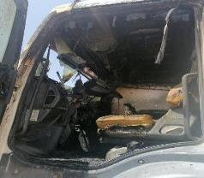
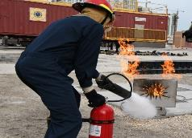
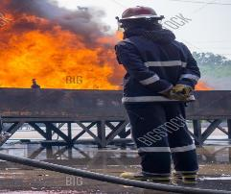
PDO Second Alert
Date: 06.05.2020 Incident title: HiPo#31
What happened?
A water tanker driver on route to deliver water heard a beep sound from the vehicle, followed by the speedometer dropping to zero. He immediately parked the vehicle at the side of the road to check the issue when smoke started coming from the dashboard A/C vents. He immediately exited the vehicle and went for the fire extinguisher, but the fire broke out and grew quickly so he decided it was too dangerous to fight the fire so did not proceed. The driver noticed a third party water tanker passing and signalled for it to stop. With assistance from the 3rd party driver, they used the water from the 3rd party tanker to extinguish the fire. The driver did not sustain any injuries or burns.
Your learning from this incident..
Always ensure you remain alert to defects occurring in your vehicle.
Always ensure you contact the emergency services as soon as it is safe to do so where required.
Always ensure you report road hazards to your management.
Always ensure you fight the fire if safe.
Always ensure you stand back in a safe area if the fire is too big to fight.
Don’t panic, assess the situation and act accordingly
Target Audience: Drilling, Operations, Logistics, Engineering, Exploration & Construction
Notes:
Ensure all dates and titles are input
A short description should be provided without mentioning names of contractors or individuals. You should include, what happened, to who (by job title) and what injuries this resulted in. Nothing more!
Four to five bullet points highlighting the main findings from the investigation. Remember the target audience is the front line staff so this should be written in simple terms in a way that everyone can understand.
The strap line should be the main point you want to get across
The images should be self explanatory, what went wrong (if you create a reconstruction please ensure you do not put people at risk) and below how it should be done.

Slide 2
Management self audit
Date: 06.05.2020 Incident title: HiPo#31
As a learning from this incident and ensure continual improvement all contract
managers must review their HSE HEMP against the questions asked below
Confirm the following:
1. Do you ensure vehicle servicing and safety inspections are up to date?
2. Do you ensure employees know the right way to react in the event of a fire?
3. Do you ensure staff know the correct number to call for emergency services?
Do you ensure all staff are trained in fire response?
Do you ensure reporting of road hazards is encouraged and are reported to the relevant department?
* If the answer is NO to any of the above questions please ensure you take action to correct this finding.
Notes:
Ensure all dates and titles are input
Make a list of closed questions (only ‘yes’ or ‘no’ as an answer) to ask others if they have the same issues based on the management or HSE-MS failings or shortfalls identified in the investigation.
Imagine you have to audit other companies to see if they could have the same issues.
These questions should start with: Do you ensure…………………?

